Slide 1
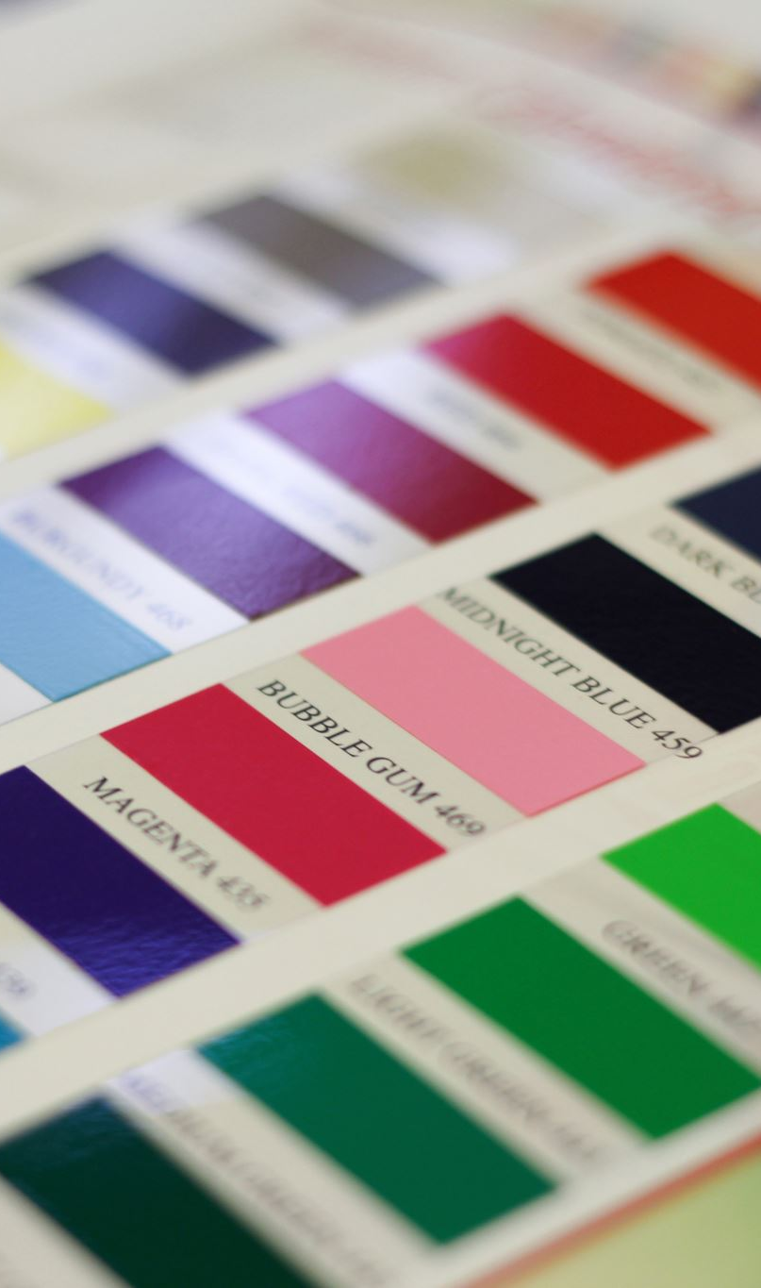
Do Multimodal Models Show Evidence of Semantic Color Discriminability?
Ryan Moreno & Laura Roettges

Slide 2



Background
Humans associate meanings with colors based on their sensory experiences, leading to color-concept associations.
Notes:
This is often easier to think of when you think about objects in the real world that are historically deemed ‘color-able’ for example when you think of a banana what color do you first think of?

Slide 3
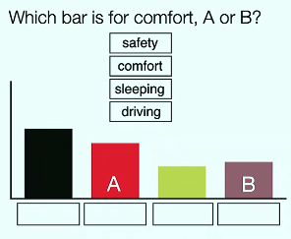
We infer semantic meaning from color choices.
We can leverage color for visual communication
Misleading color encodings impede effective communication

Slide 4
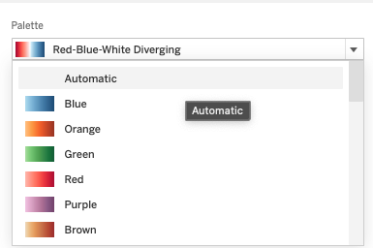
Motivation: Automatic Color Palette Generation
Notes:
Ultimately there is a need for automating palette generation particularly for data visualizations (think of the default colors provided in Tableau or your python visualization libraries you may use) , with the goal of suggesting semantically interpretable colors particularly when encoding categorical values with color.
_______
Gathering color-concept association scores from human trials is costly, especially when scaling to the many concepts that require categorical color encodings for effective data visualizations

Slide 5
Previous Literature

Slide 6
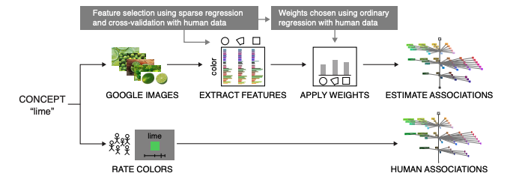
Estimating Color-Concept Associations from Image Statistics
Ragini Rathore, Zachary Leggon, Laurent Lessard, and Karen B. Schlos
Notes:
Figure 3. Illustration of our pipeline for automatically extracting color distributions from images. The bottom flow (concepts to color ratings to human associations) describes the slow yet reliable direct approach using human experiments to determine ground truth associations. The top flow involves querying Google Images, extracting colors using a variety of different methods (features), then weighting those features appropriately to obtain estimated associations. Deciding which features to use and how to weight them is learned from human association data using sparse regression and cross-validation. Once the model is trained, color-concept associations can be quickly estimated for new concepts without additional human data.

Slide 7
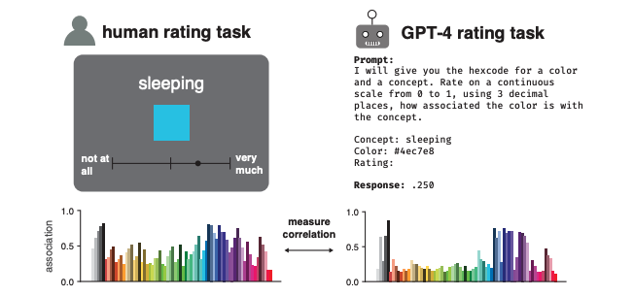
Large Language Models Estimate Fine-Grained Human Color-Concept Associations
Kushin Mukherjee, Timothy T. Rogers, Karen B. Schloss
Notes:
Figure 2: Example trial from the human color-concept association rating task (left) and GPT-4 rating task for the same color-concept pair (right). Bar graphs correspond to average human and GPT-4 color concept association ratings for the concept “bird” over the entire UW-71 color library.

Slide 8
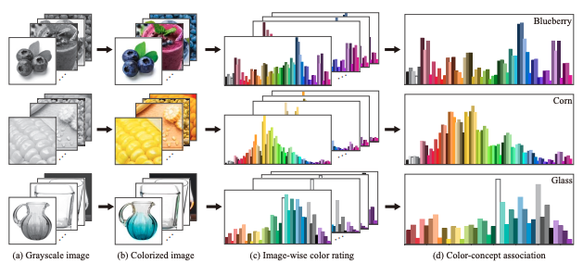
Self-Supervised Color Concept Association via Image Colorization
Ruizhen Hu, Ziqi Ye, Bin Chen, Oliver van Kaick, and Hui Huang
Notes:
Fig 1: We introduce a method for automatically extracting color-concept associations from natural images. We apply a colorization neural network to predict color distributions for the input images. The distributions are transformed into ratings for a color library, which are then aggregated across multiple images of a concept to provide the color-concept associations.

Slide 9
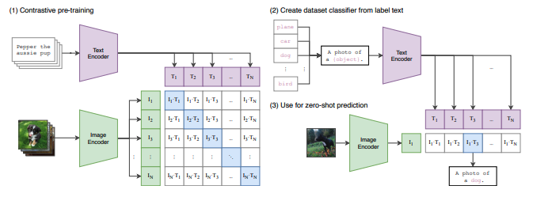
Our Approach: Zero-Shot transfer for Multimodal Models (CLIP)
How well do pretrained multimodal models perform at understanding color concept associations?
Figure from A. Radford, et al. Learning transferable visual models from natural language supervision. ICML 2021
Notes:
Figure 1. Summary of our approach. While standard image models jointly train an image feature extractor and a linear classifier to predict some label, CLIP jointly trains an image encoder and a atext encoder to predict the correct pairings of a batch of (image, text) training examples. At test time the learned text encoder synthesizes a zero-shot linear classifier by embedding the names or descriptions of the target dataset’s classes.

Slide 10
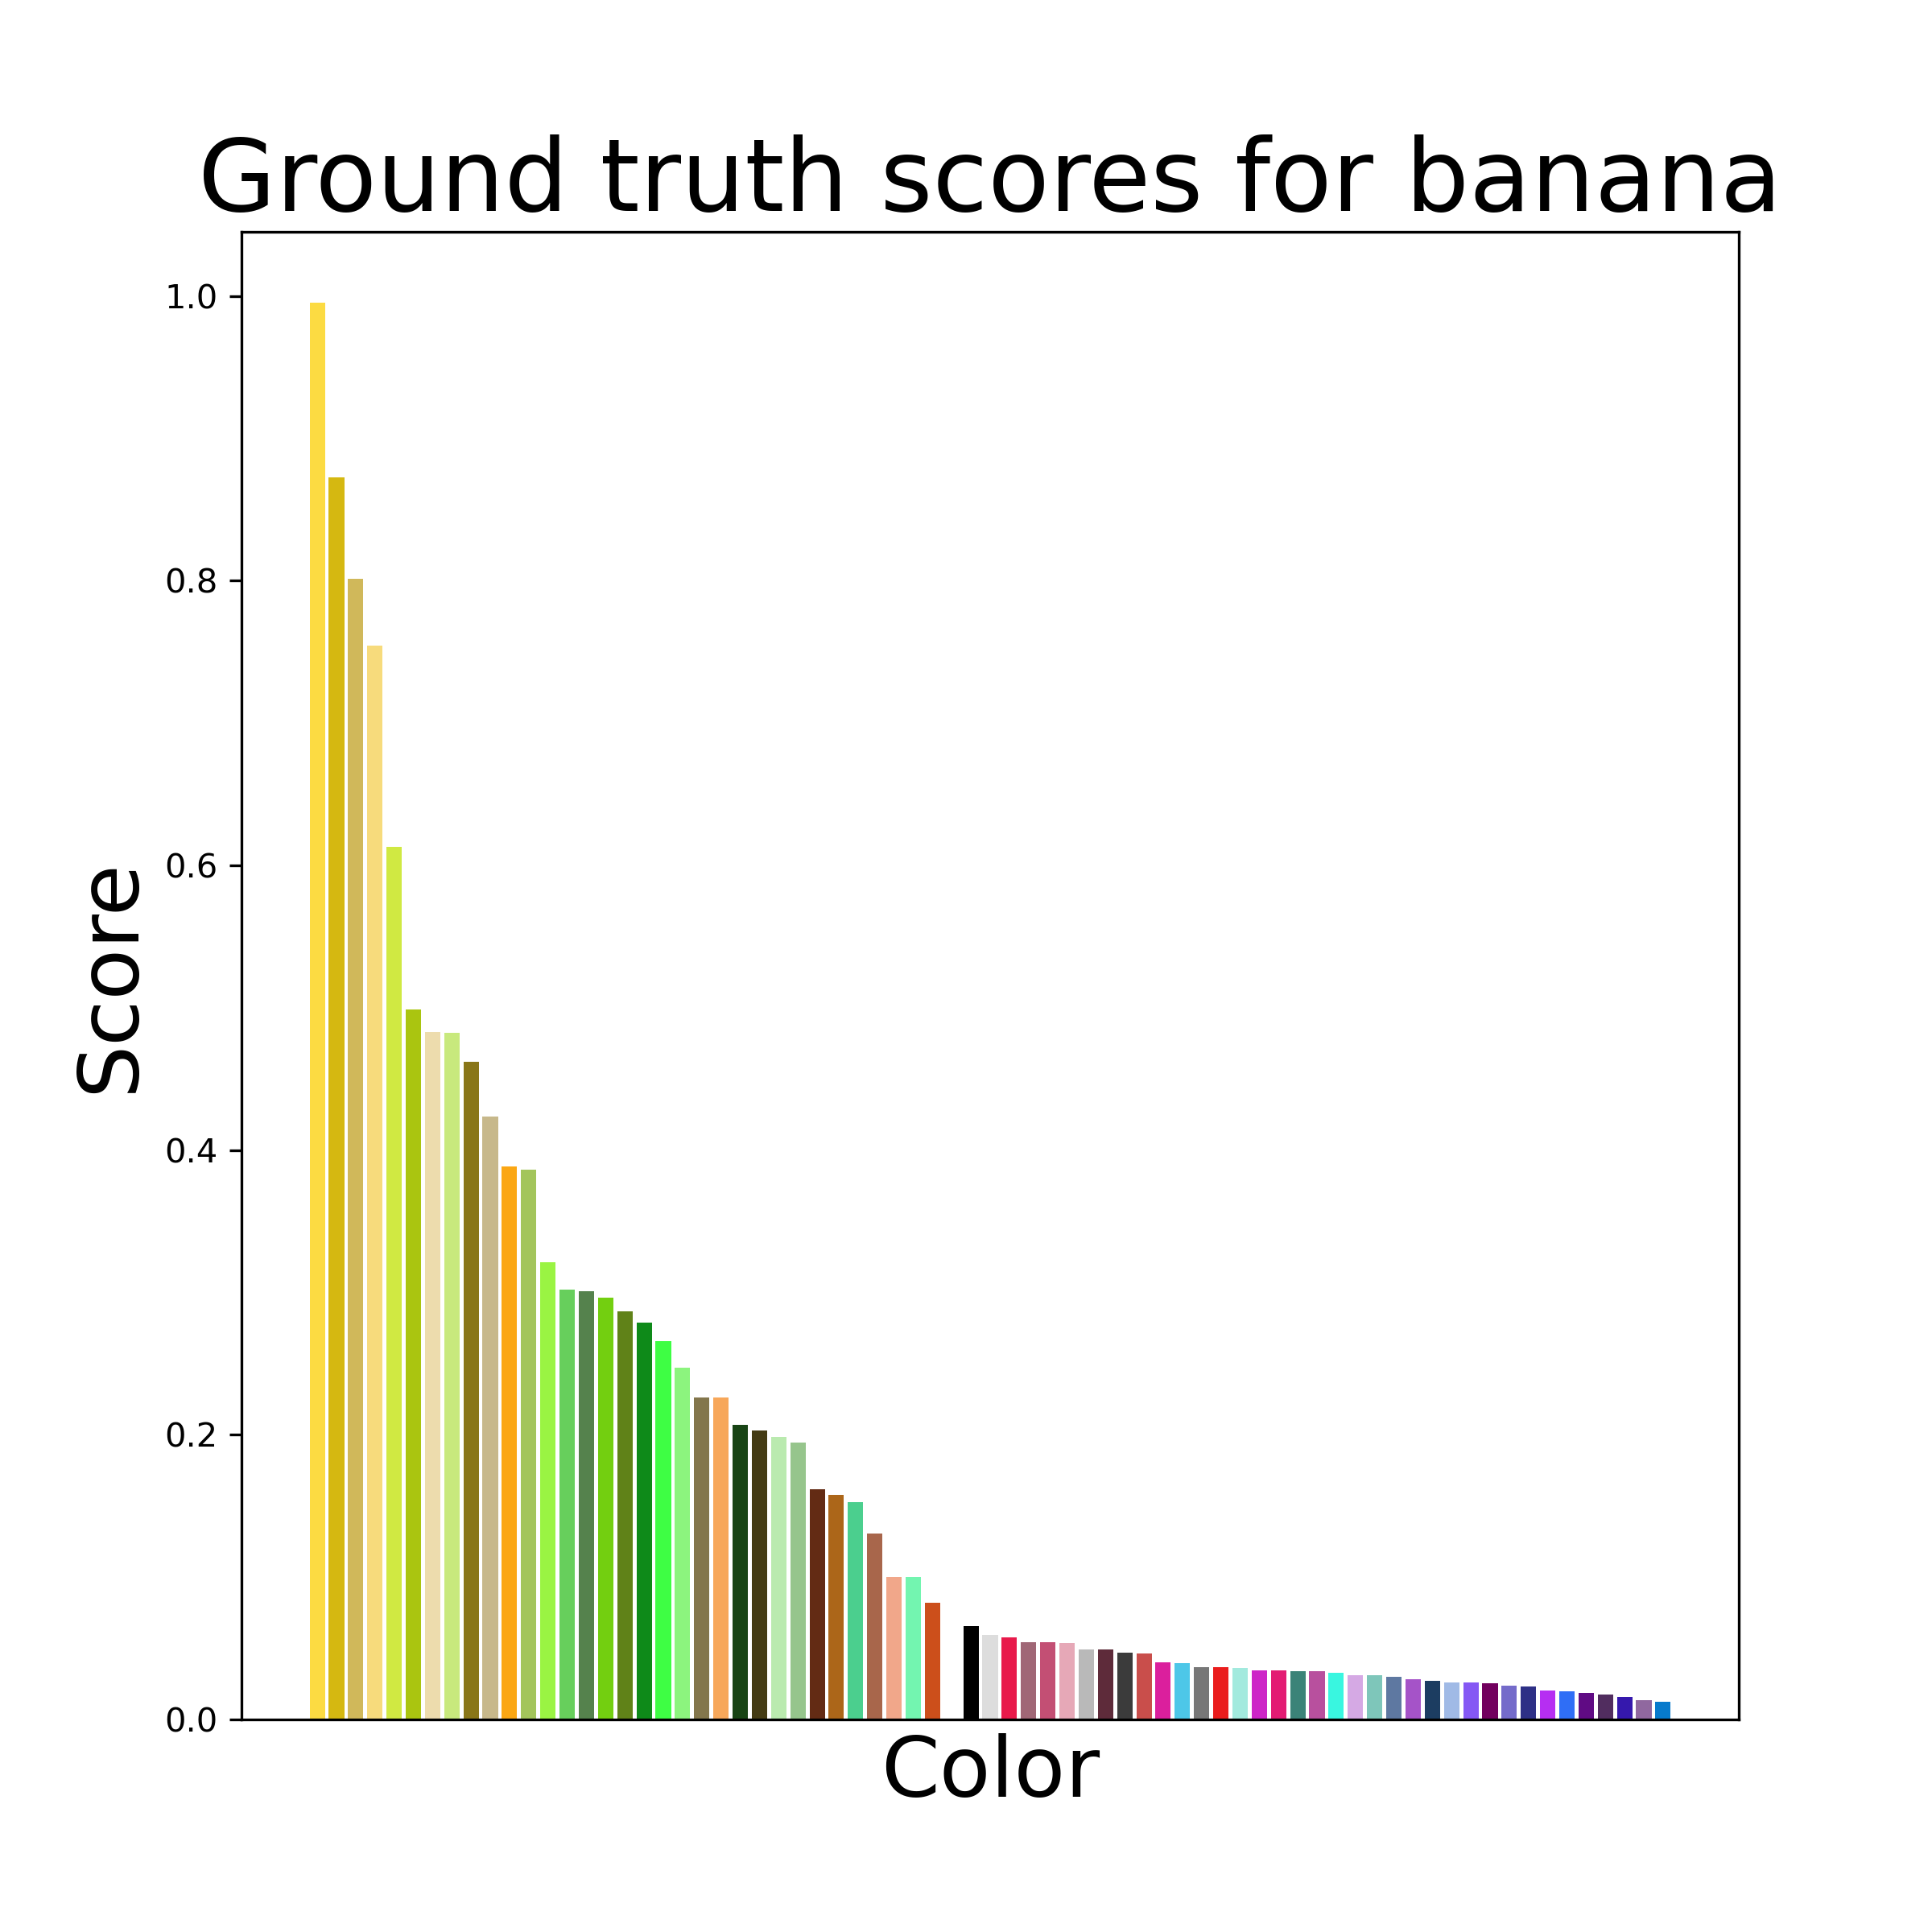
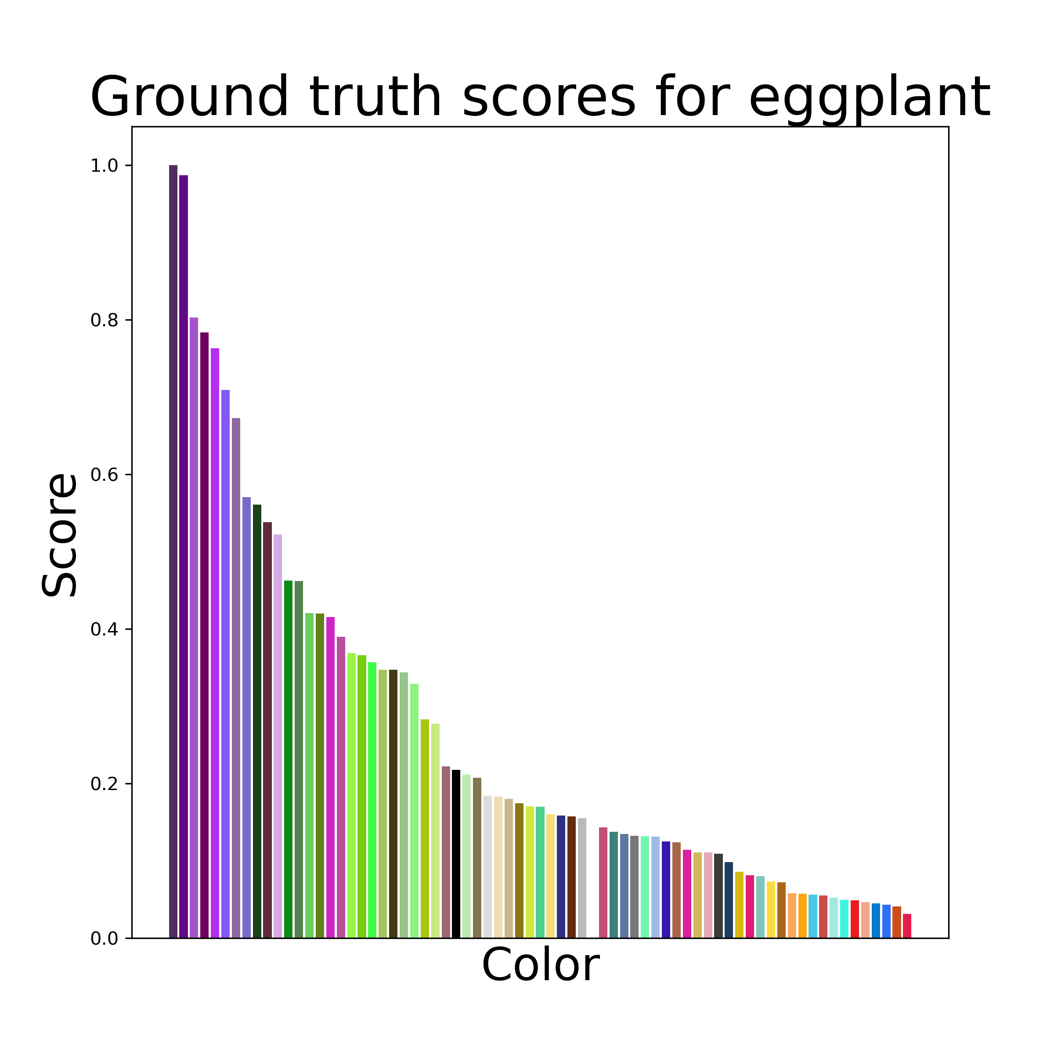
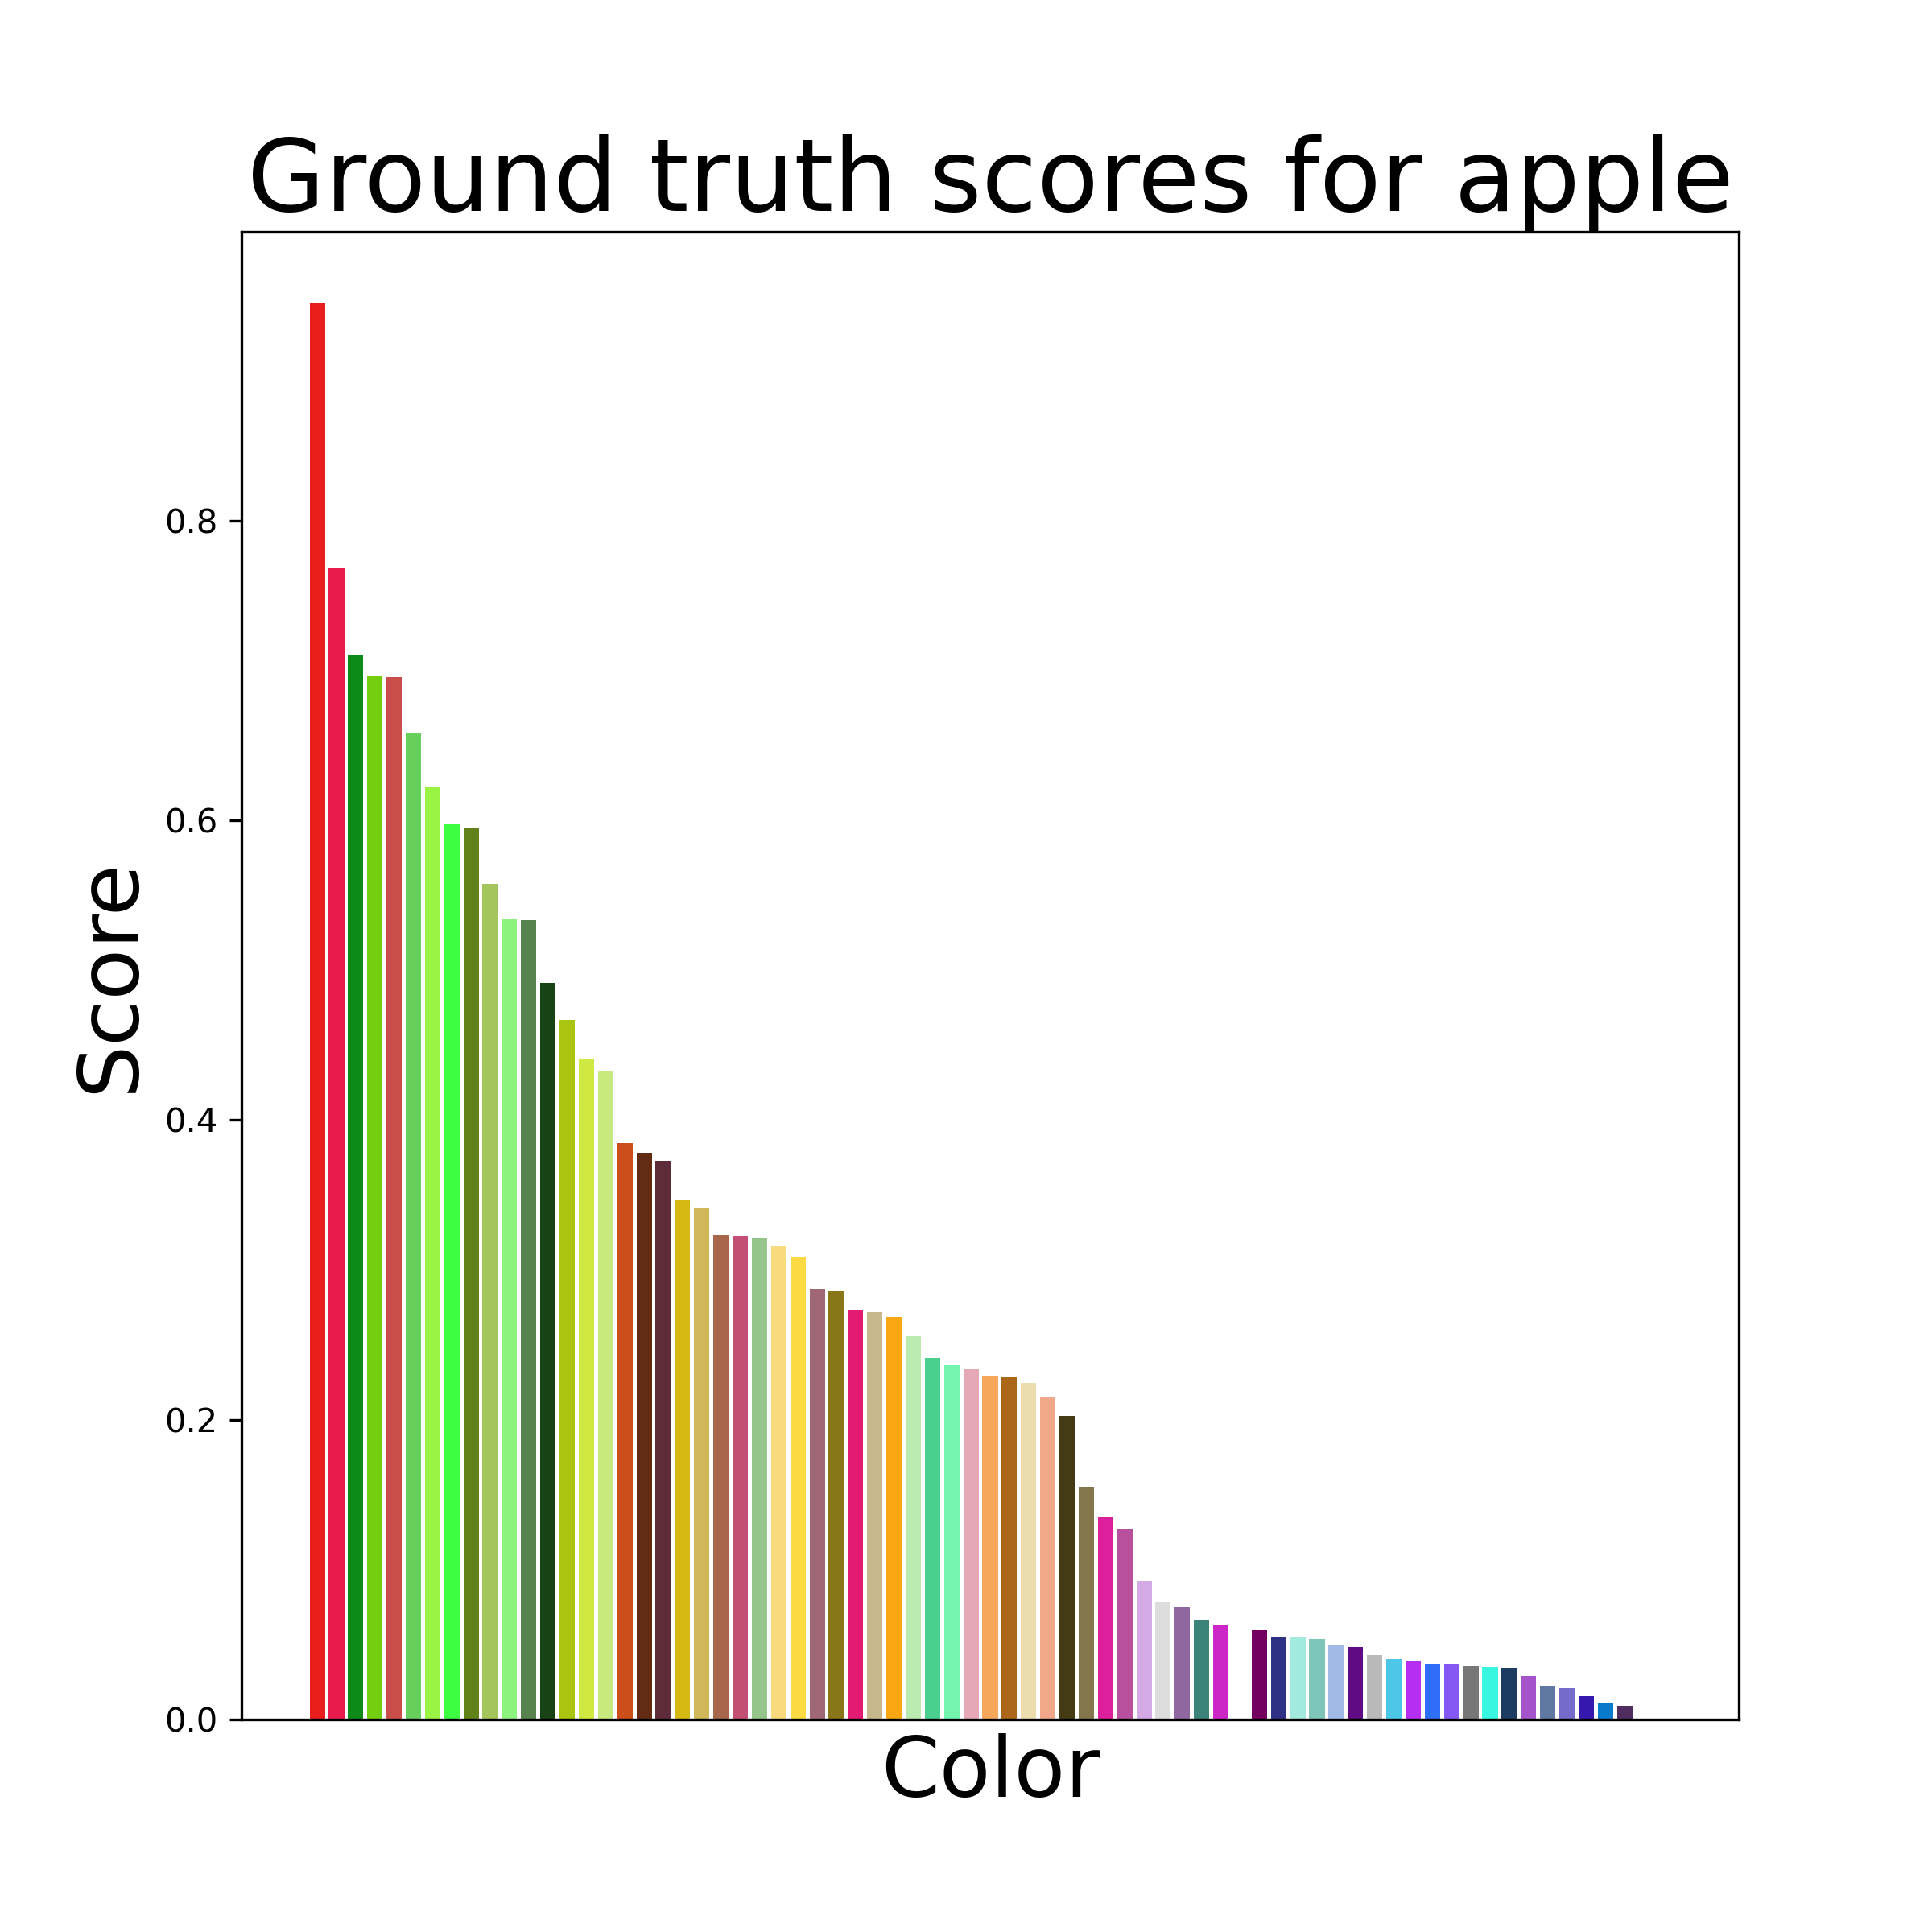
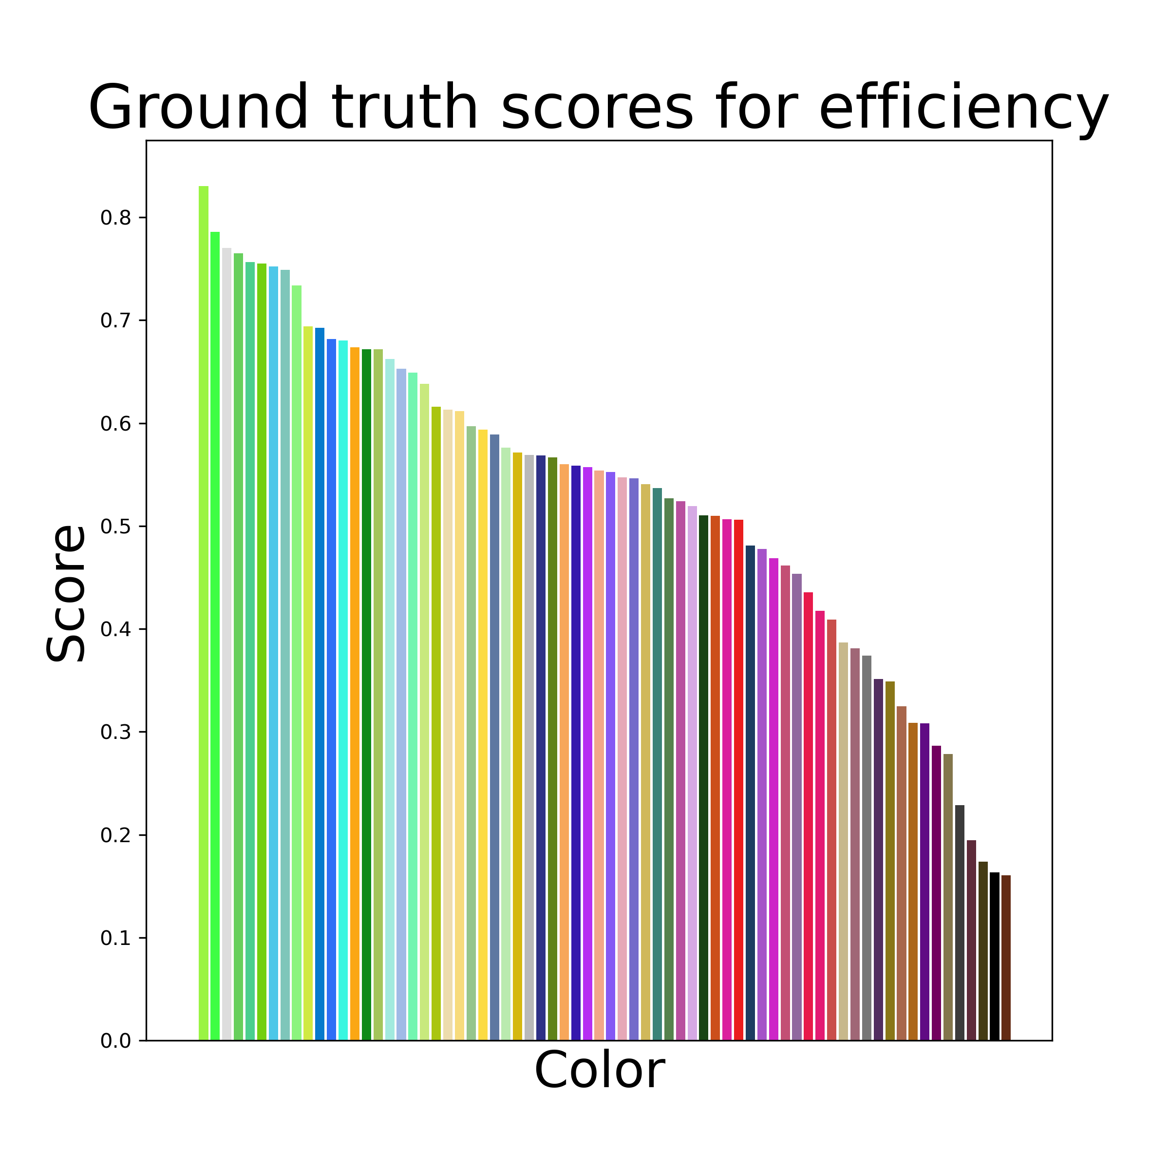
Data
Human trial color concept associations
20 concepts
71 colors
Courtesy of Schloss Visual Reasoning Lab
Notes:
The data we are using was share by the Schloss Visual reasoning lab, we had 20 concepts and 71 colors which are defined in CIELAB space, these serve as the ground truth data for our experiment. These were also used in the Large Language Models paper though the other studies used a set of 51 color from the same space and a separate set of concepts.
https://schlosslab.discovery.wisc.edu/

Slide 11
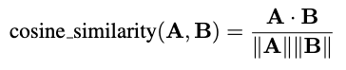
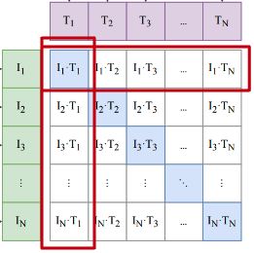








The color of the image represents the word apple.
The color of the image represents the word banana.
The color of the image represents the word carrot.
The color of the image represents the word celery.
The color of the image represents the word cherry.
The color of the image represents the word comfort.
The color of the image represents the word corn.
The color of the image represents the word driving.
The color of the image represents the word eating.
The color of the image represents the word efficiency.
The color of the image represents the word eggplant.
The color of the image represents the word grape.
The color of the image represents the word leisure.
The color of the image represents the word mushroom.
The color of the image represents the word peach.
The color of the image represents the word reliability.
The color of the image represents the word safety.
The color of the image represents the word sleeping.
The color of the image represents the word speed.
The color of the image represents the word working.
Color-concept association score:
Text Encoder
Experiment 1: Bidirectional Transformer using Byte-Pair Encoding (BPE) for tokenization
Experiment 2: LLM enhanced transformer leveraging Llama3-8B-CC
x3 prompt formats
Image Encoder
Experiment 1: ViT B 32
Experiment 2: ViT B 16
RGB images based on UW 71 CIELAB colors
Notes:
TODO: write up a script for this slide to explain the Contrastive Finetuning and differences in the text encoders across the 2 experiments
____________________________________________

Slide 12
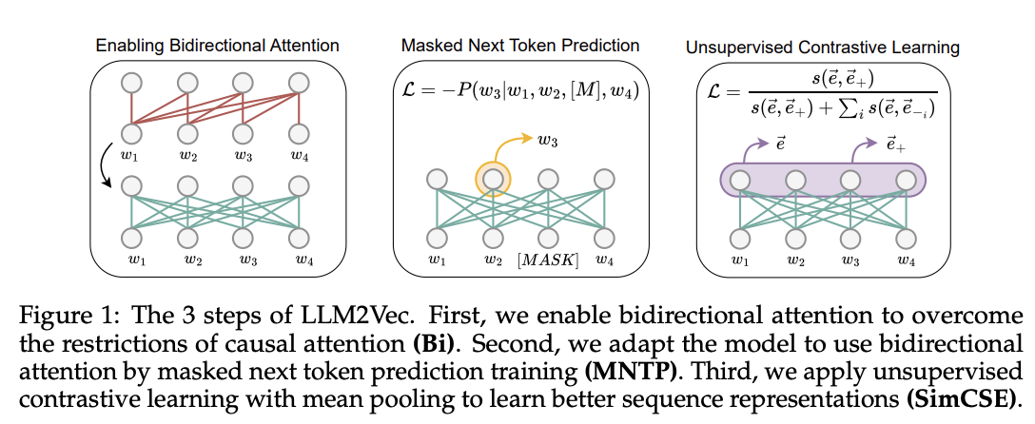
https://arxiv.org/pdf/2404.05961
Notes:
https://arxiv.org/pdf/2404.05961

Slide 13
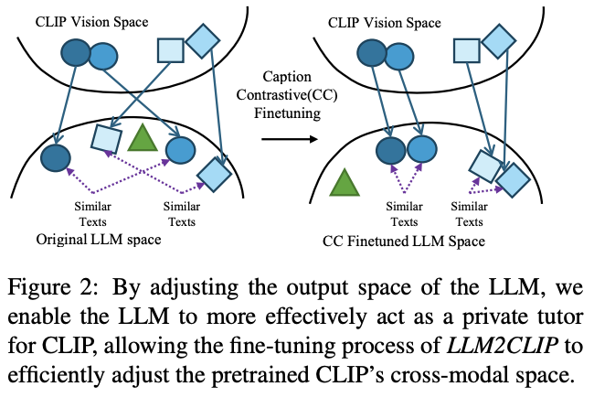
https://arxiv.org/pdf/2411.04997
Notes:
https://arxiv.org/pdf/2411.04997

Slide 14
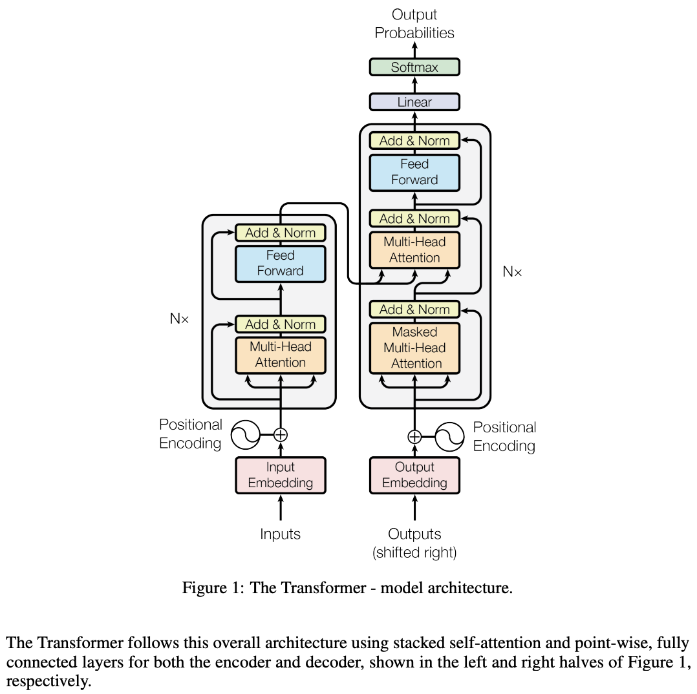
Feature | Attention Is All You Need | Language Models are Unsupervised Multitask Learners | CLIP
Architecture | Encoder-Decoder | Decoder-Only | Dual-Stream (Separate Image and Text Encoders)
Attention | Bidirectional (in encoder) | Unidirectional (causal masking) | Bidirectional (text encoder) + Global attention for image encoder
Training Approach | Supervised (e.g., translation) | Unsupervised (next-token prediction) | Contrastive learning for image-text alignment
Task-Specificity | Designed for specific tasks (e.g., translation) | General-purpose multitask learning | General-purpose multimodal learning
Positional Encodings | Static sinusoidal | Static sinusoidal (retained) | Static sinusoidal (text) + learned 2D embeddings (image)
Scaling | Small-scale models | Large-scale models with more parameters | Massive dataset (400M image-text pairs); scaled models
Tokenization | Language-specific | Byte-Pair Encoding (BPE) | BPE for text; images tokenized into patches (ViT)
Optimization | Standard Adam, fixed LR schedule | Advanced techniques (layer norm, gradient clipping) | AdamW optimizer, weight decay, and learning rate warmup
Zero-Shot Learning | Not addressed | Emergent behavior through unsupervised pretraining | Emergent behavior through multimodal pretraining
Objective Function | Cross-Entropy for token prediction | Cross-Entropy for next-token prediction | Contrastive loss for aligning image-text embeddings
Attention Is All You Need Framework
Notes:
https://arxiv.org/pdf/1706.03762
OpenAI modified the attention mechanism to be unidirectional (causal) for the decoder-only architecture. Each token can only attend to itself and tokens before it. This ensures that predictions depend only on prior context, making it suitable for language modeling, where future tokens are not available during training.
Focus shifted to unsupervised pretraining on large, diverse text corpora (e.g., books, articles, and web data). The model learns general-purpose language representations by predicting the next token across a vast range of natural text.
In LMUML: Improvements included:Layer normalization adjustments: Normalization was applied differently to stabilize training in large models.
Gradient clipping: Used to prevent exploding gradients.
Learning rate schedules: Adjustments to learning rates for better convergence during pretraining on large datasets.
In LMUML: OpenAI used Byte-Pair Encoding (BPE) for tokenization to process diverse text inputs efficiently while ensuring compatibility with the unsupervised training pipeline.
In "Attention Is All You Need": The Transformer consists of both an encoder and a decoder:The encoder processes input sequences.
The decoder generates output sequences, attending to both its own generated tokens and the encoder's representations.
In LMUML: The model uses only the decoder stack of the Transformer, with no encoder. This simplifies the architecture and is optimized for autoregressive generation (predicting the next token in a sequence).
In "Attention Is All You Need": Positional encodings were static, sinusoidal vectors added to input embeddings to help the model recognize token order.
In LMUML: OpenAI retained sinusoidal positional encodings without major modifications, though subsequent work like GPT-2 and GPT-3 explored trainable positional encodings.

Slide 15
diff betw ViT B 32 & Microsoft version
CLIP ViT B 32 | Microsoft LLM2CLIP
Vision Transformer, text encoder is a transformer as well Image patch size 32x32 pixels Text encoder limited to 77 tokens | Builds on CLIP’s ViT B 16 model for the image encoder LLM enhanced transformer for text encoding - leverages Llama3 as the text encoder Image patch size 16x16 pixels (Argues it is better suited for tasks requiring detailed image analysis or understanding complex textual semantics.)
Notes:
LLM2CLIP is a fine-tuning strategy for CLIP, consisting of two stages. The first stage aims to improve the separability of the LLM’s output space, and the second stage involves fine-tuning by replacing CLIP’s text model with the LLM.
CLIP text encoder paragraph from paper: The text encoder is a Transformer (Vaswani et al., 2017) with the architecture modifications described in Radford et al. (2019). As a base size we use a 63M-parameter 12- layer 512-wide model with 8 attention heads. The transformer operates on a lower-cased byte pair encoding (BPE) representation of the text with a 49,152 vocab size (Sennrich et al., 2015). For computational efficiency, the max sequence length was capped at 76. The text sequence is bracketed with [SOS] and [EOS] tokens and the activations of the highest layer of the transformer at the [EOS] token are treated as the feature representation of the text which is layer normalized and then linearly projected into the multi-modal embedding space. Masked self-attention was used in the text encoder to preserve the ability to initialize with a pre-trained language model or add language modeling as an auxiliary objective, though exploration of this is left as future work.

Slide 16

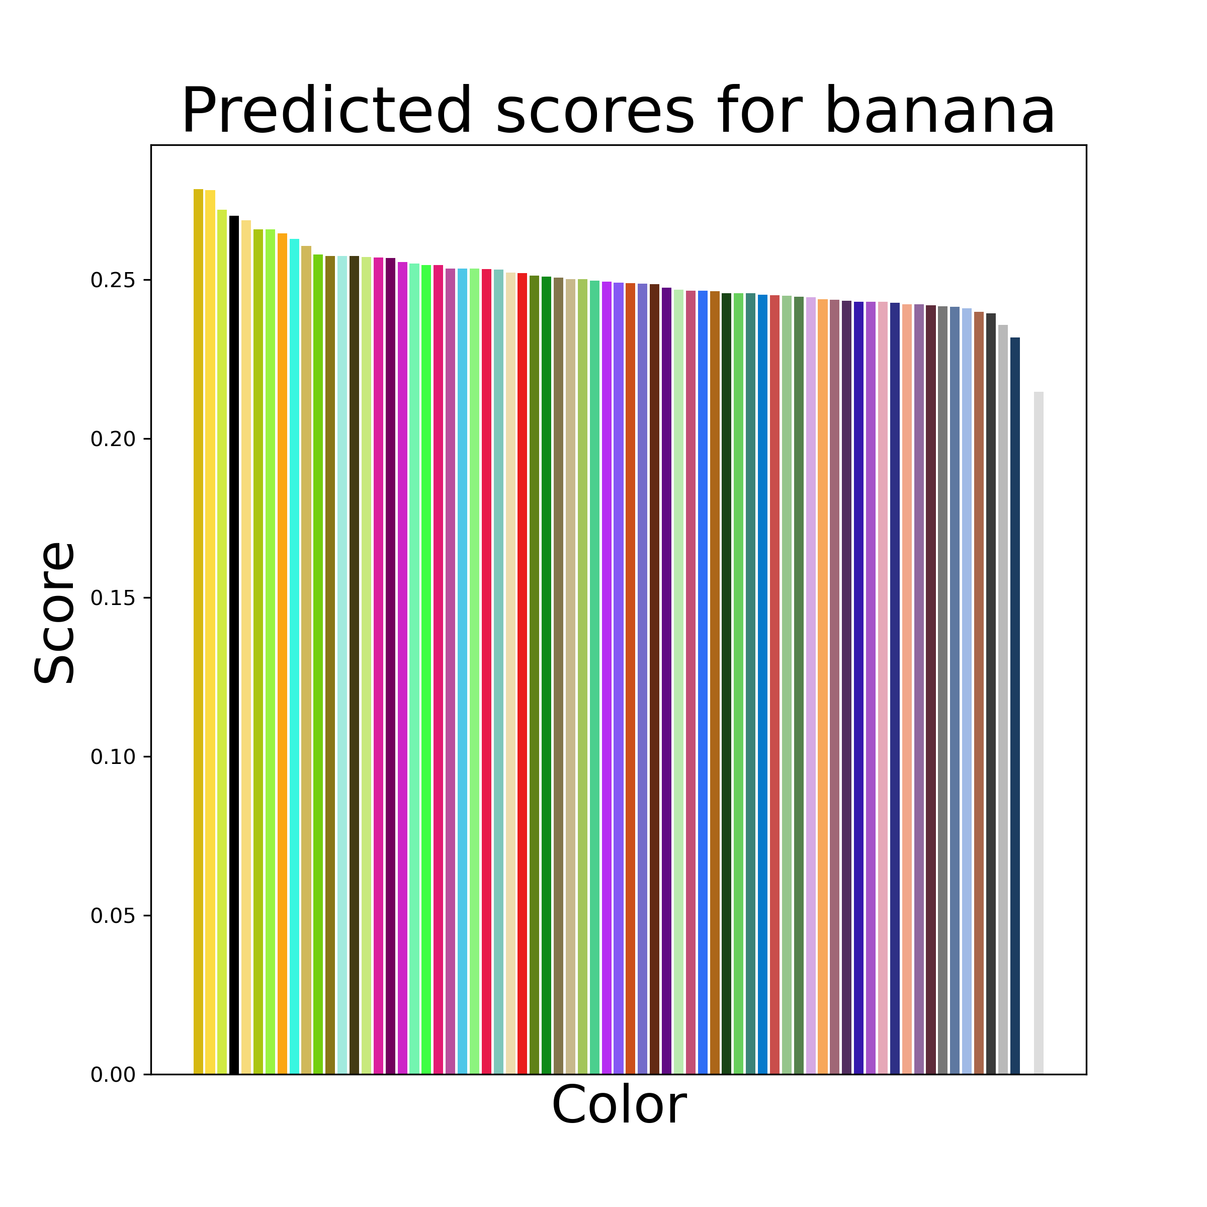

Results
CLIP ViT 32 & Prompt 1
Notes:
As we discussed, we used the cosine similarity of the color block and concept embeddings as their association score. For each concept, this allows us to rank the colors. We’ll look through a few categories to see what this looks like.
Here we have the ground truth colorings for banana from a human trial compared to our model’s predicted colorings. Interestingly, our model has a much smaller range of association scores, but is still able to capture a similar ranking pattern. In particular, we can see that our model ranks the yellow colors at the top followed by many of the light green colors.

Slide 17
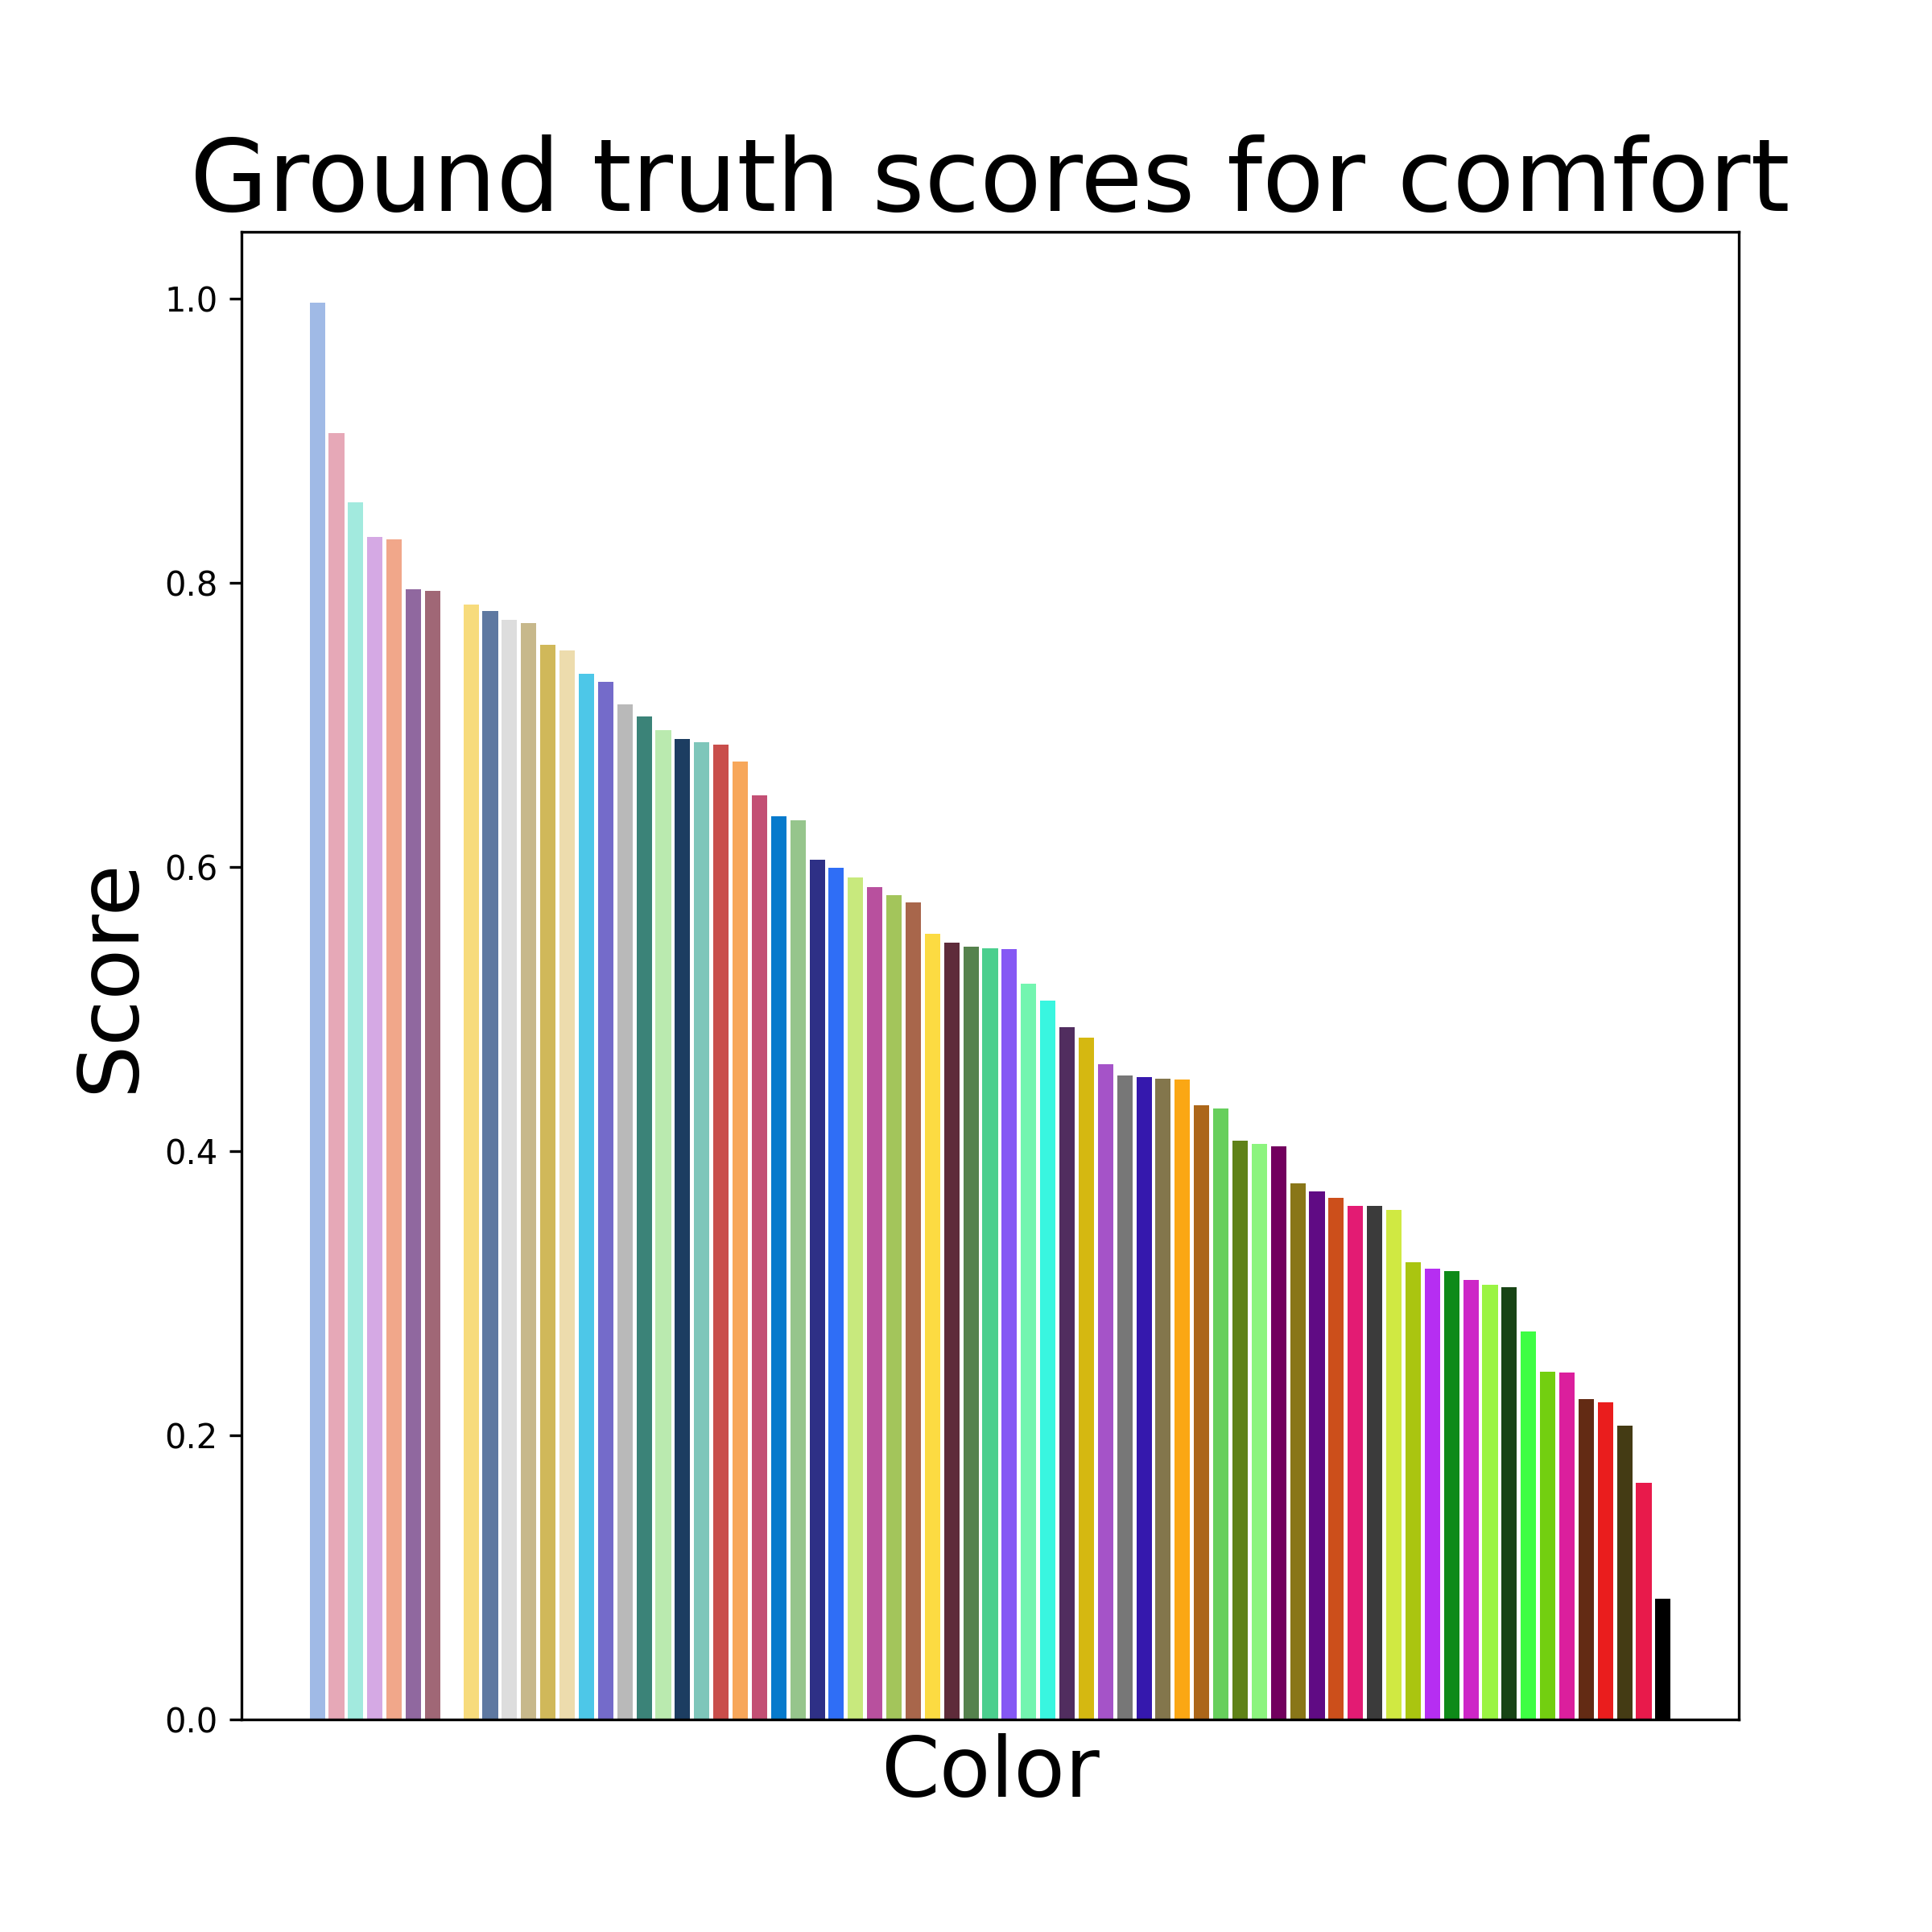
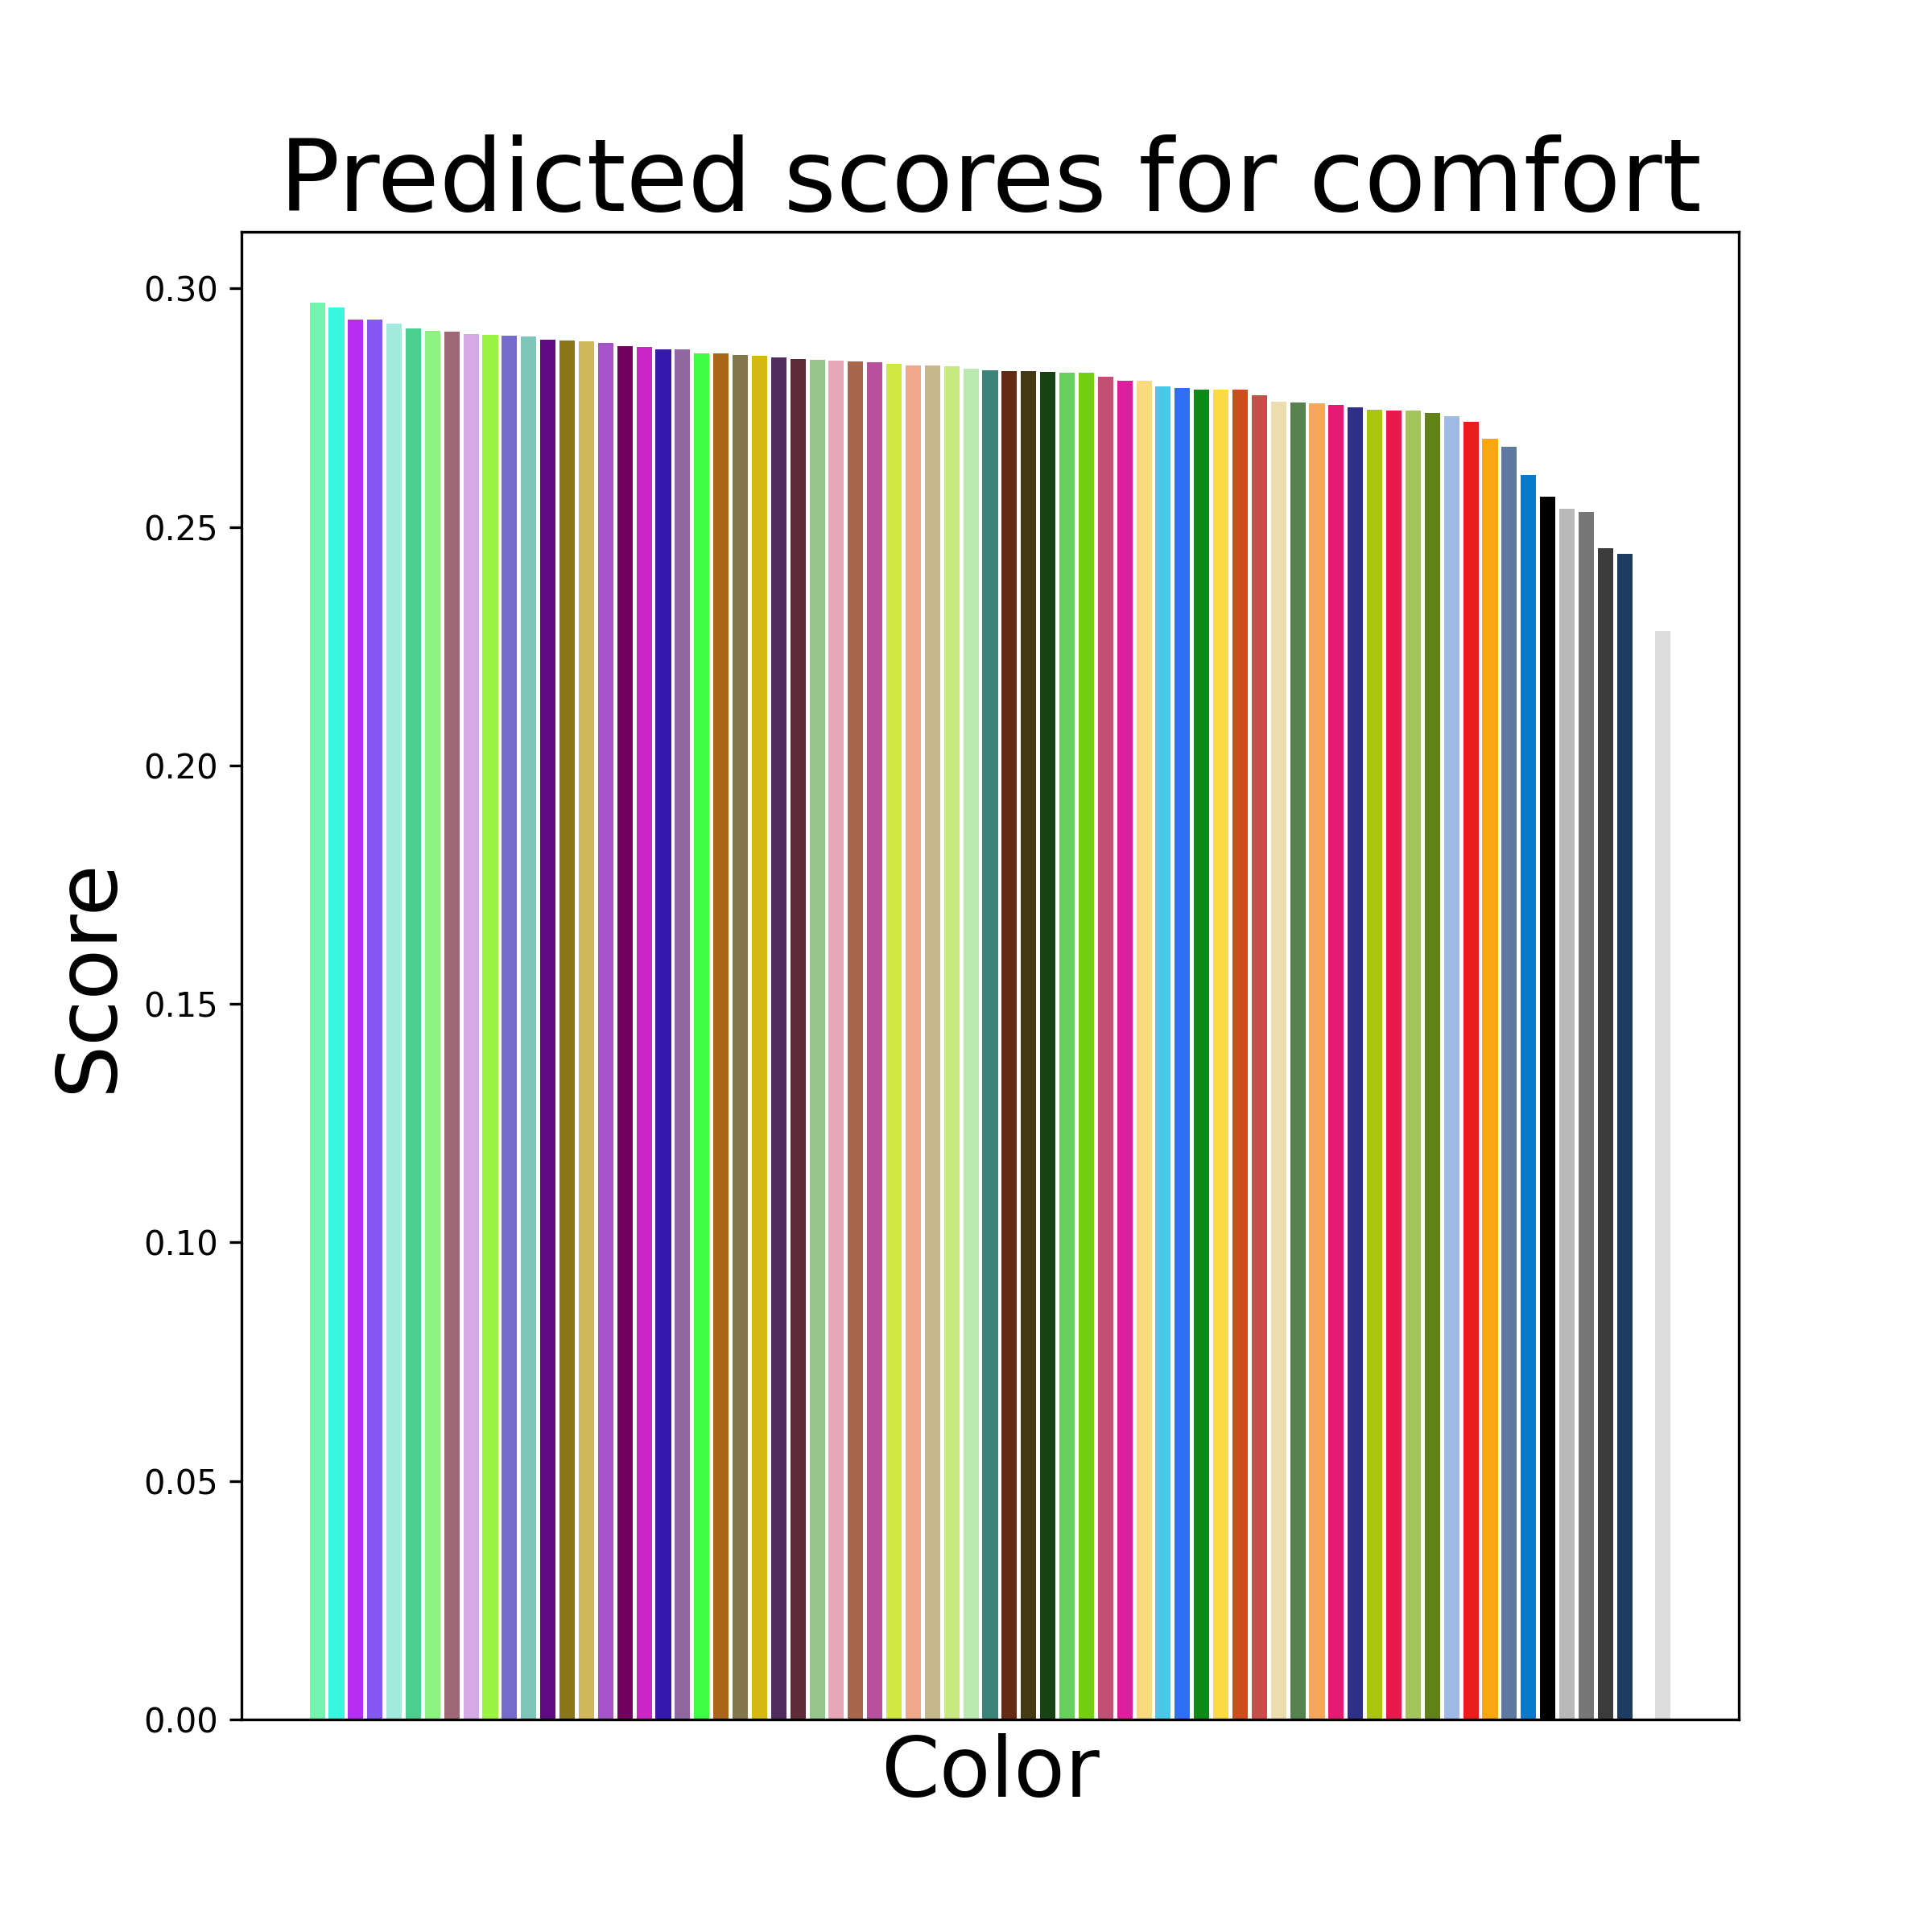
Results
CLIP ViT 32 & Prompt 1
Notes:
As might be expected, we found that our model performs markedly better when attempting to color physical objects as opposed to abstract ideas. Here are the results for the concept “comfort”, where we can see that our color rankings do not align at all with the ground truth color rankings.

Slide 18
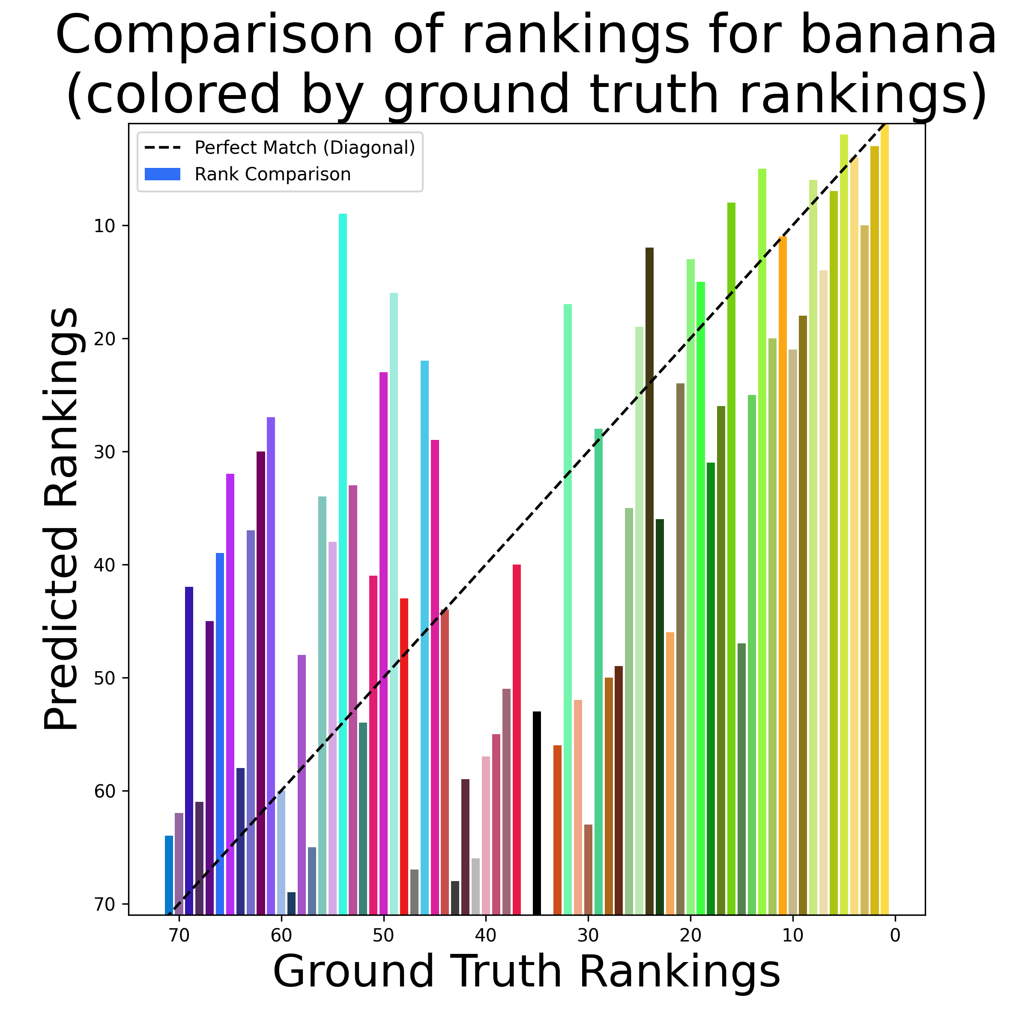
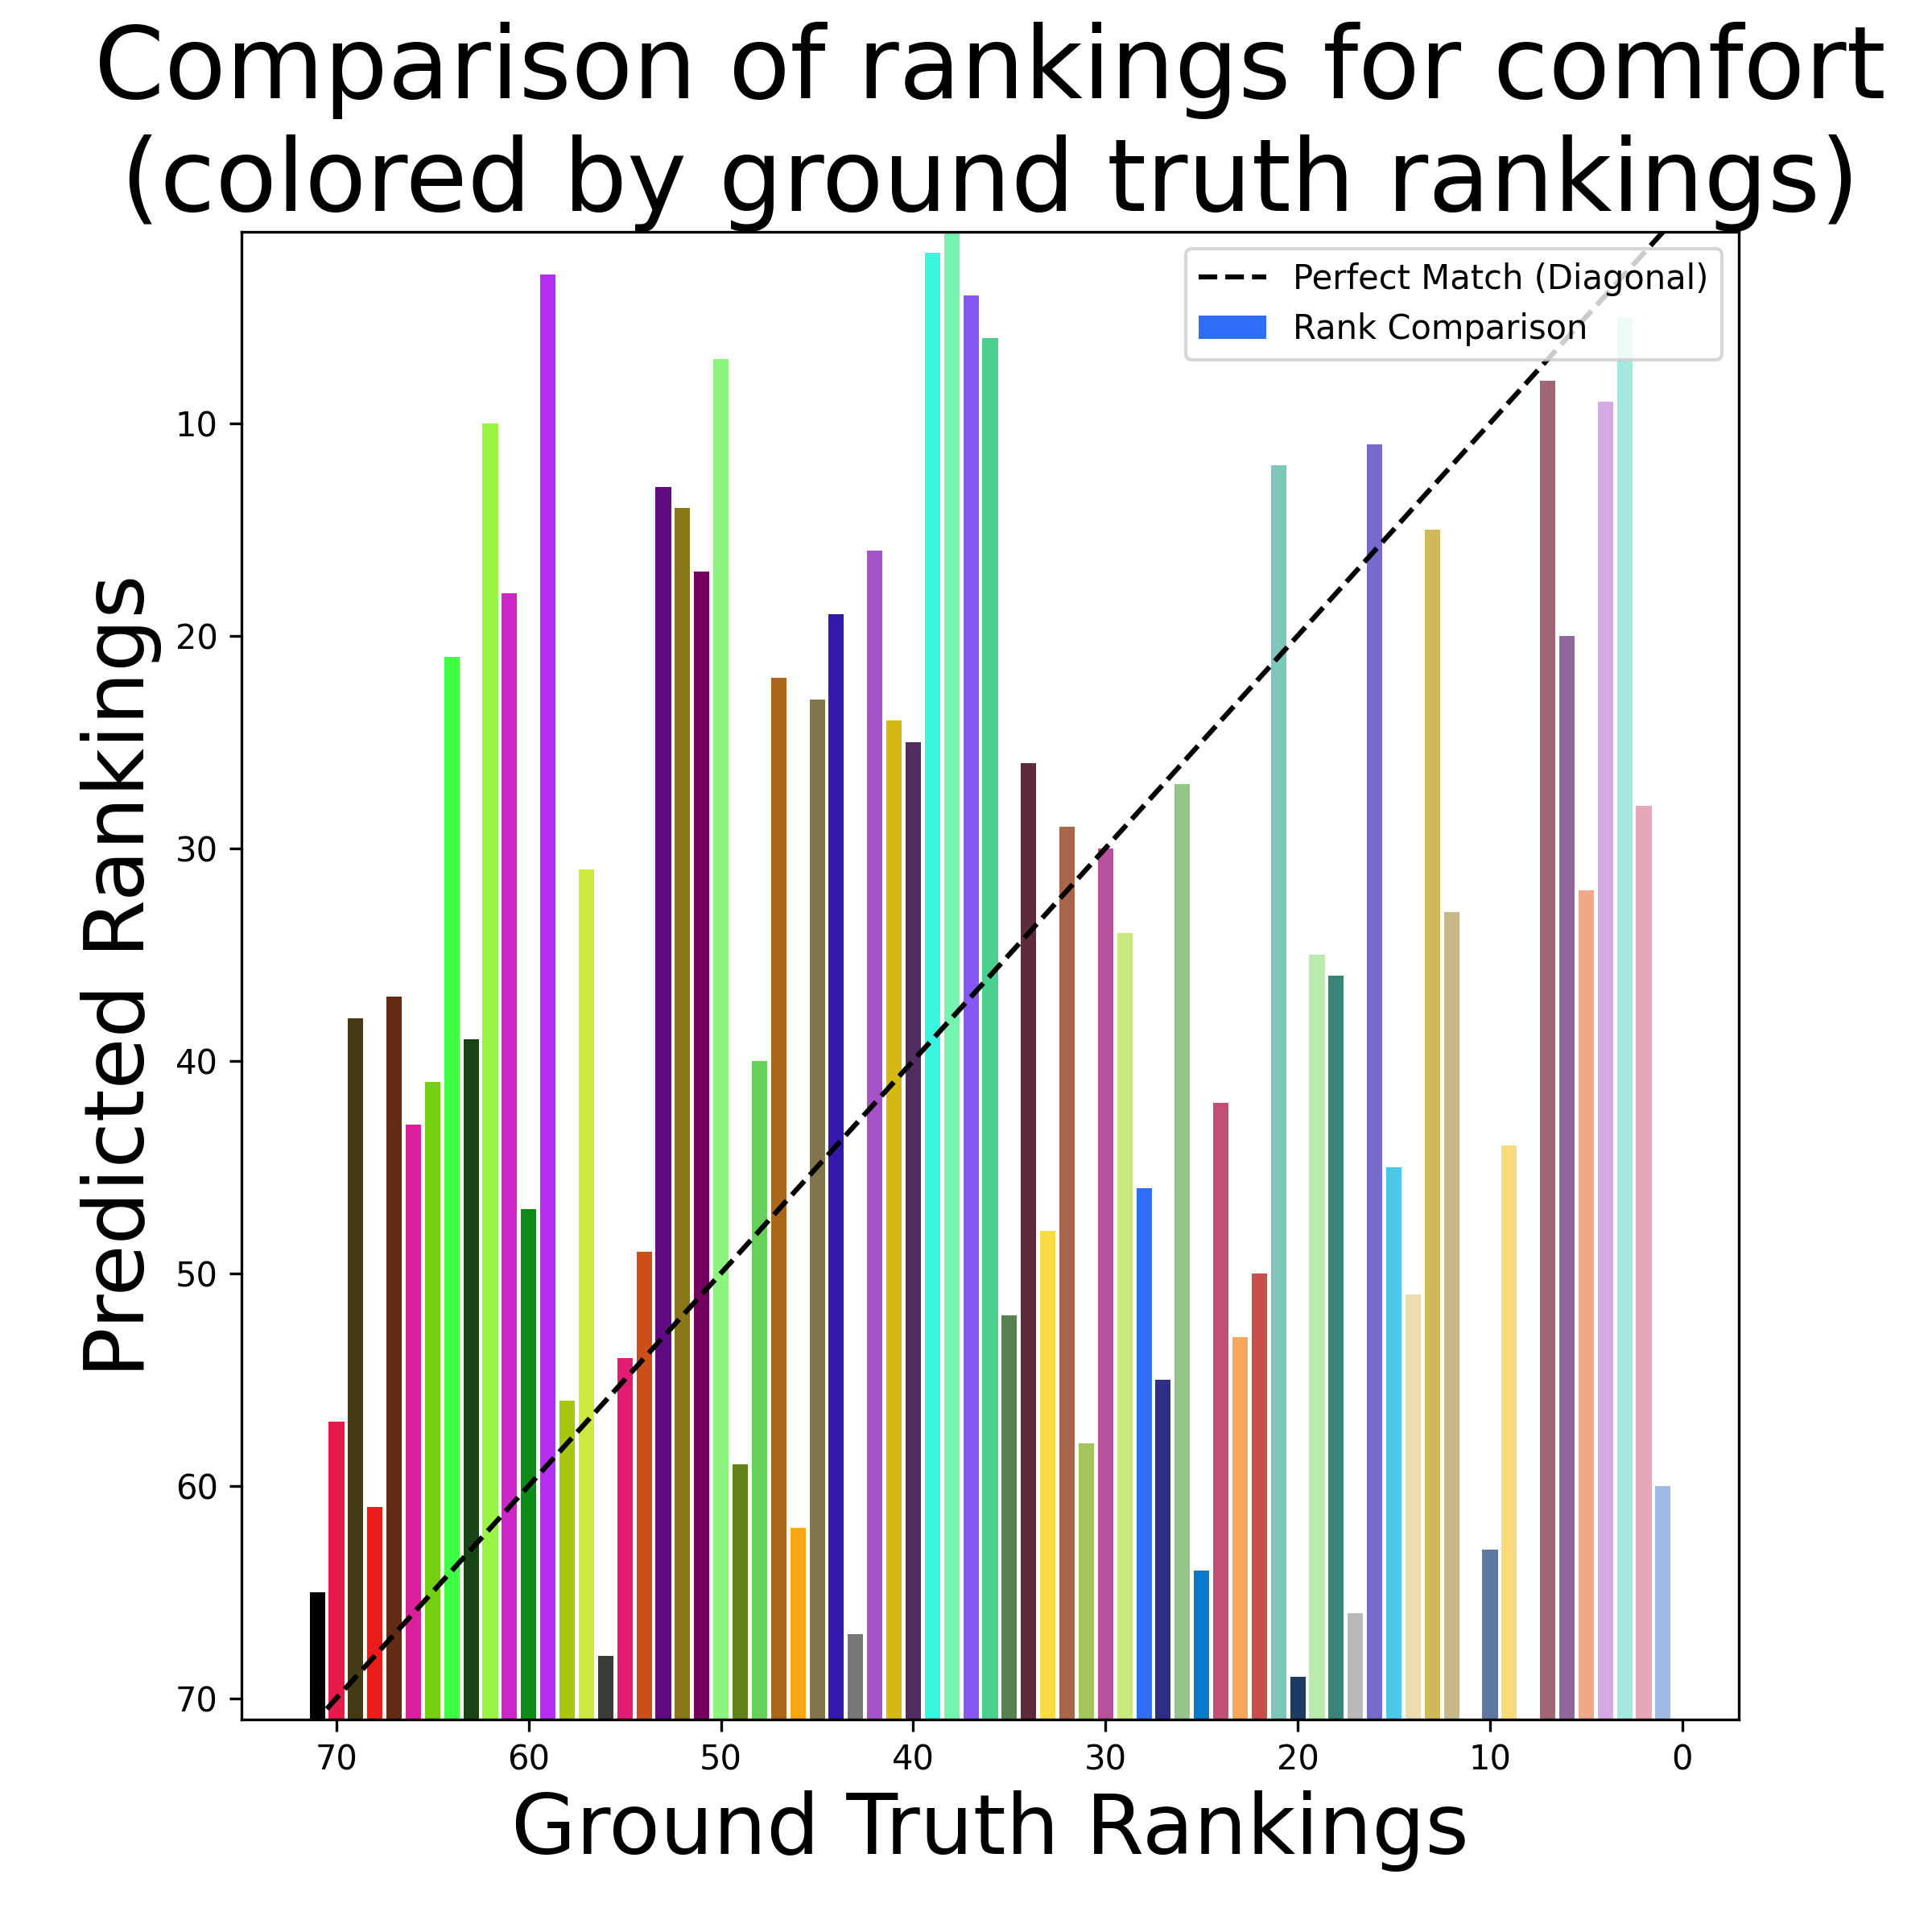
Results
CLIP ViT 32 & Prompt 1
Notes:
To highlight the difference in performance on physical objects and abstract concepts, we can compare the rank distributions. The bars are colored by the ground truth colorings, with the colors increasing in association from left to right, according to ground truth. The height of the bar indicates the ranking our model gave, with a taller bar meaning that the color was predicted to be well associated with the concept. If our model was to predict the exact same ordering of colors, the bars would align along this dotted diagonal line. The colorings for banana align quite well, especially for the most associated colors. In contrast, the color rankings for comfort show almost no correlation.

Slide 19

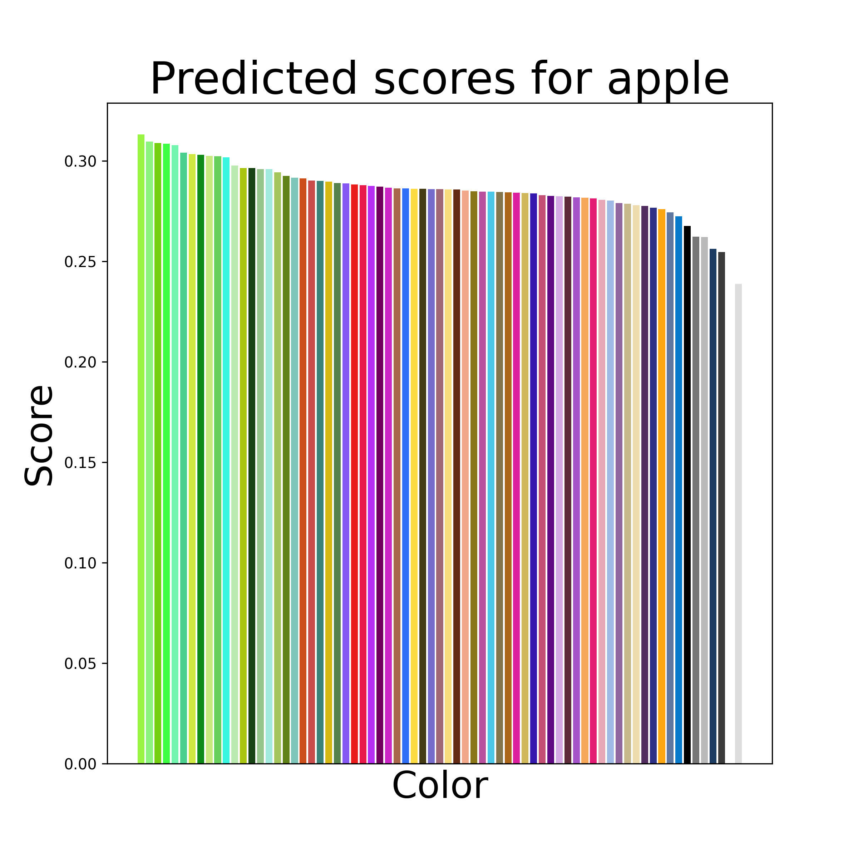
Results
CLIP ViT 32 & Prompt 1
Notes:
As another example, apple is an interesting category because the ground truth score has red colors and then green colors while our model predicts green and then red colors. Of course, both of these colors make sense semantically since there are red and green varieties of apples.
This suggests that it may be useful to consider the strength of the association score in addition to the rankings of the colors when evaluating our model. We considered a handful of metrics to capture the distance between the the ground truth color association score distribution and our predicted distribution for a given concept. For the purposes of simplicity, we’ll focus on just the Pearson Correlation Coefficient for the rest of the presentation.

Slide 20


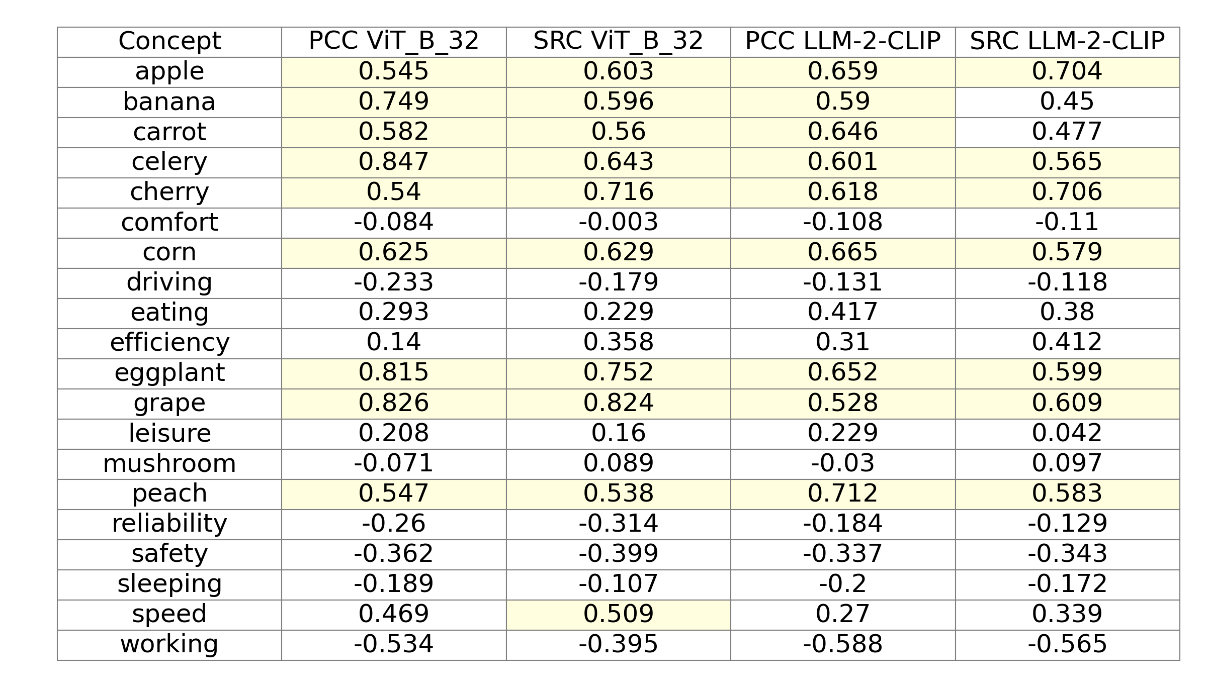
Exp 1 & 2:
Comparison of predicted and ground truth association scores
Pearson Correlation Coefficient (PCC)
Spearman Rank Correlation (SRC)
Notes:
Used many metrics but primarily Pearson Correlation Coefficient (PCC) and Spearman Rank Correlation (SRC). Many results show strong positive correlation, highlighted are values over .5)
PCC measures the linear relationship between two variables. It assumes the relationship can be described with a straight line.
SRC measures the monotonic relationship between two variables. It assesses how well the relationship can be described by a consistently increasing or decreasing function, even if the relationship is not linear.

Slide 21
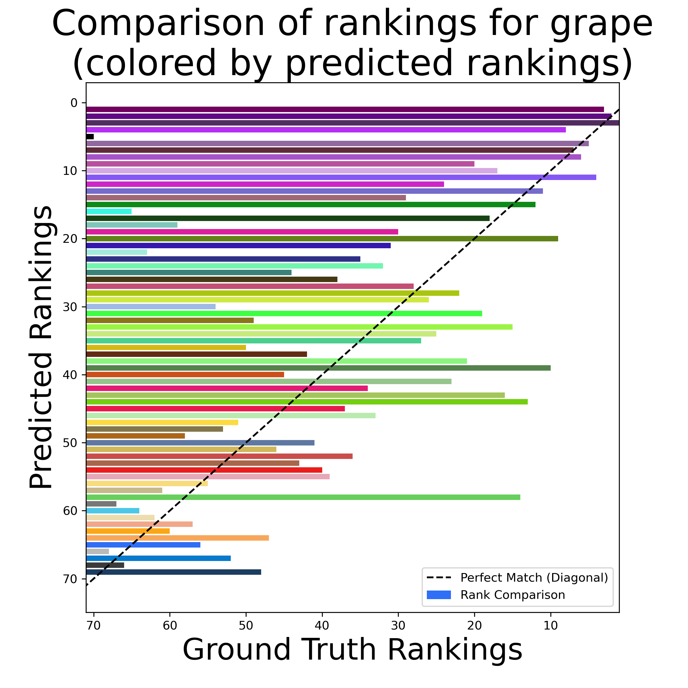
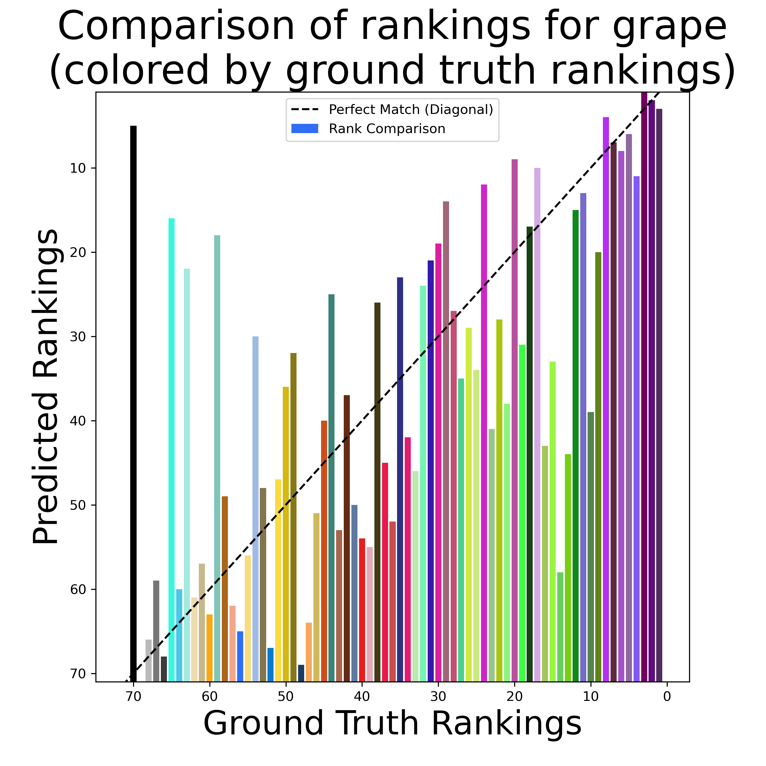
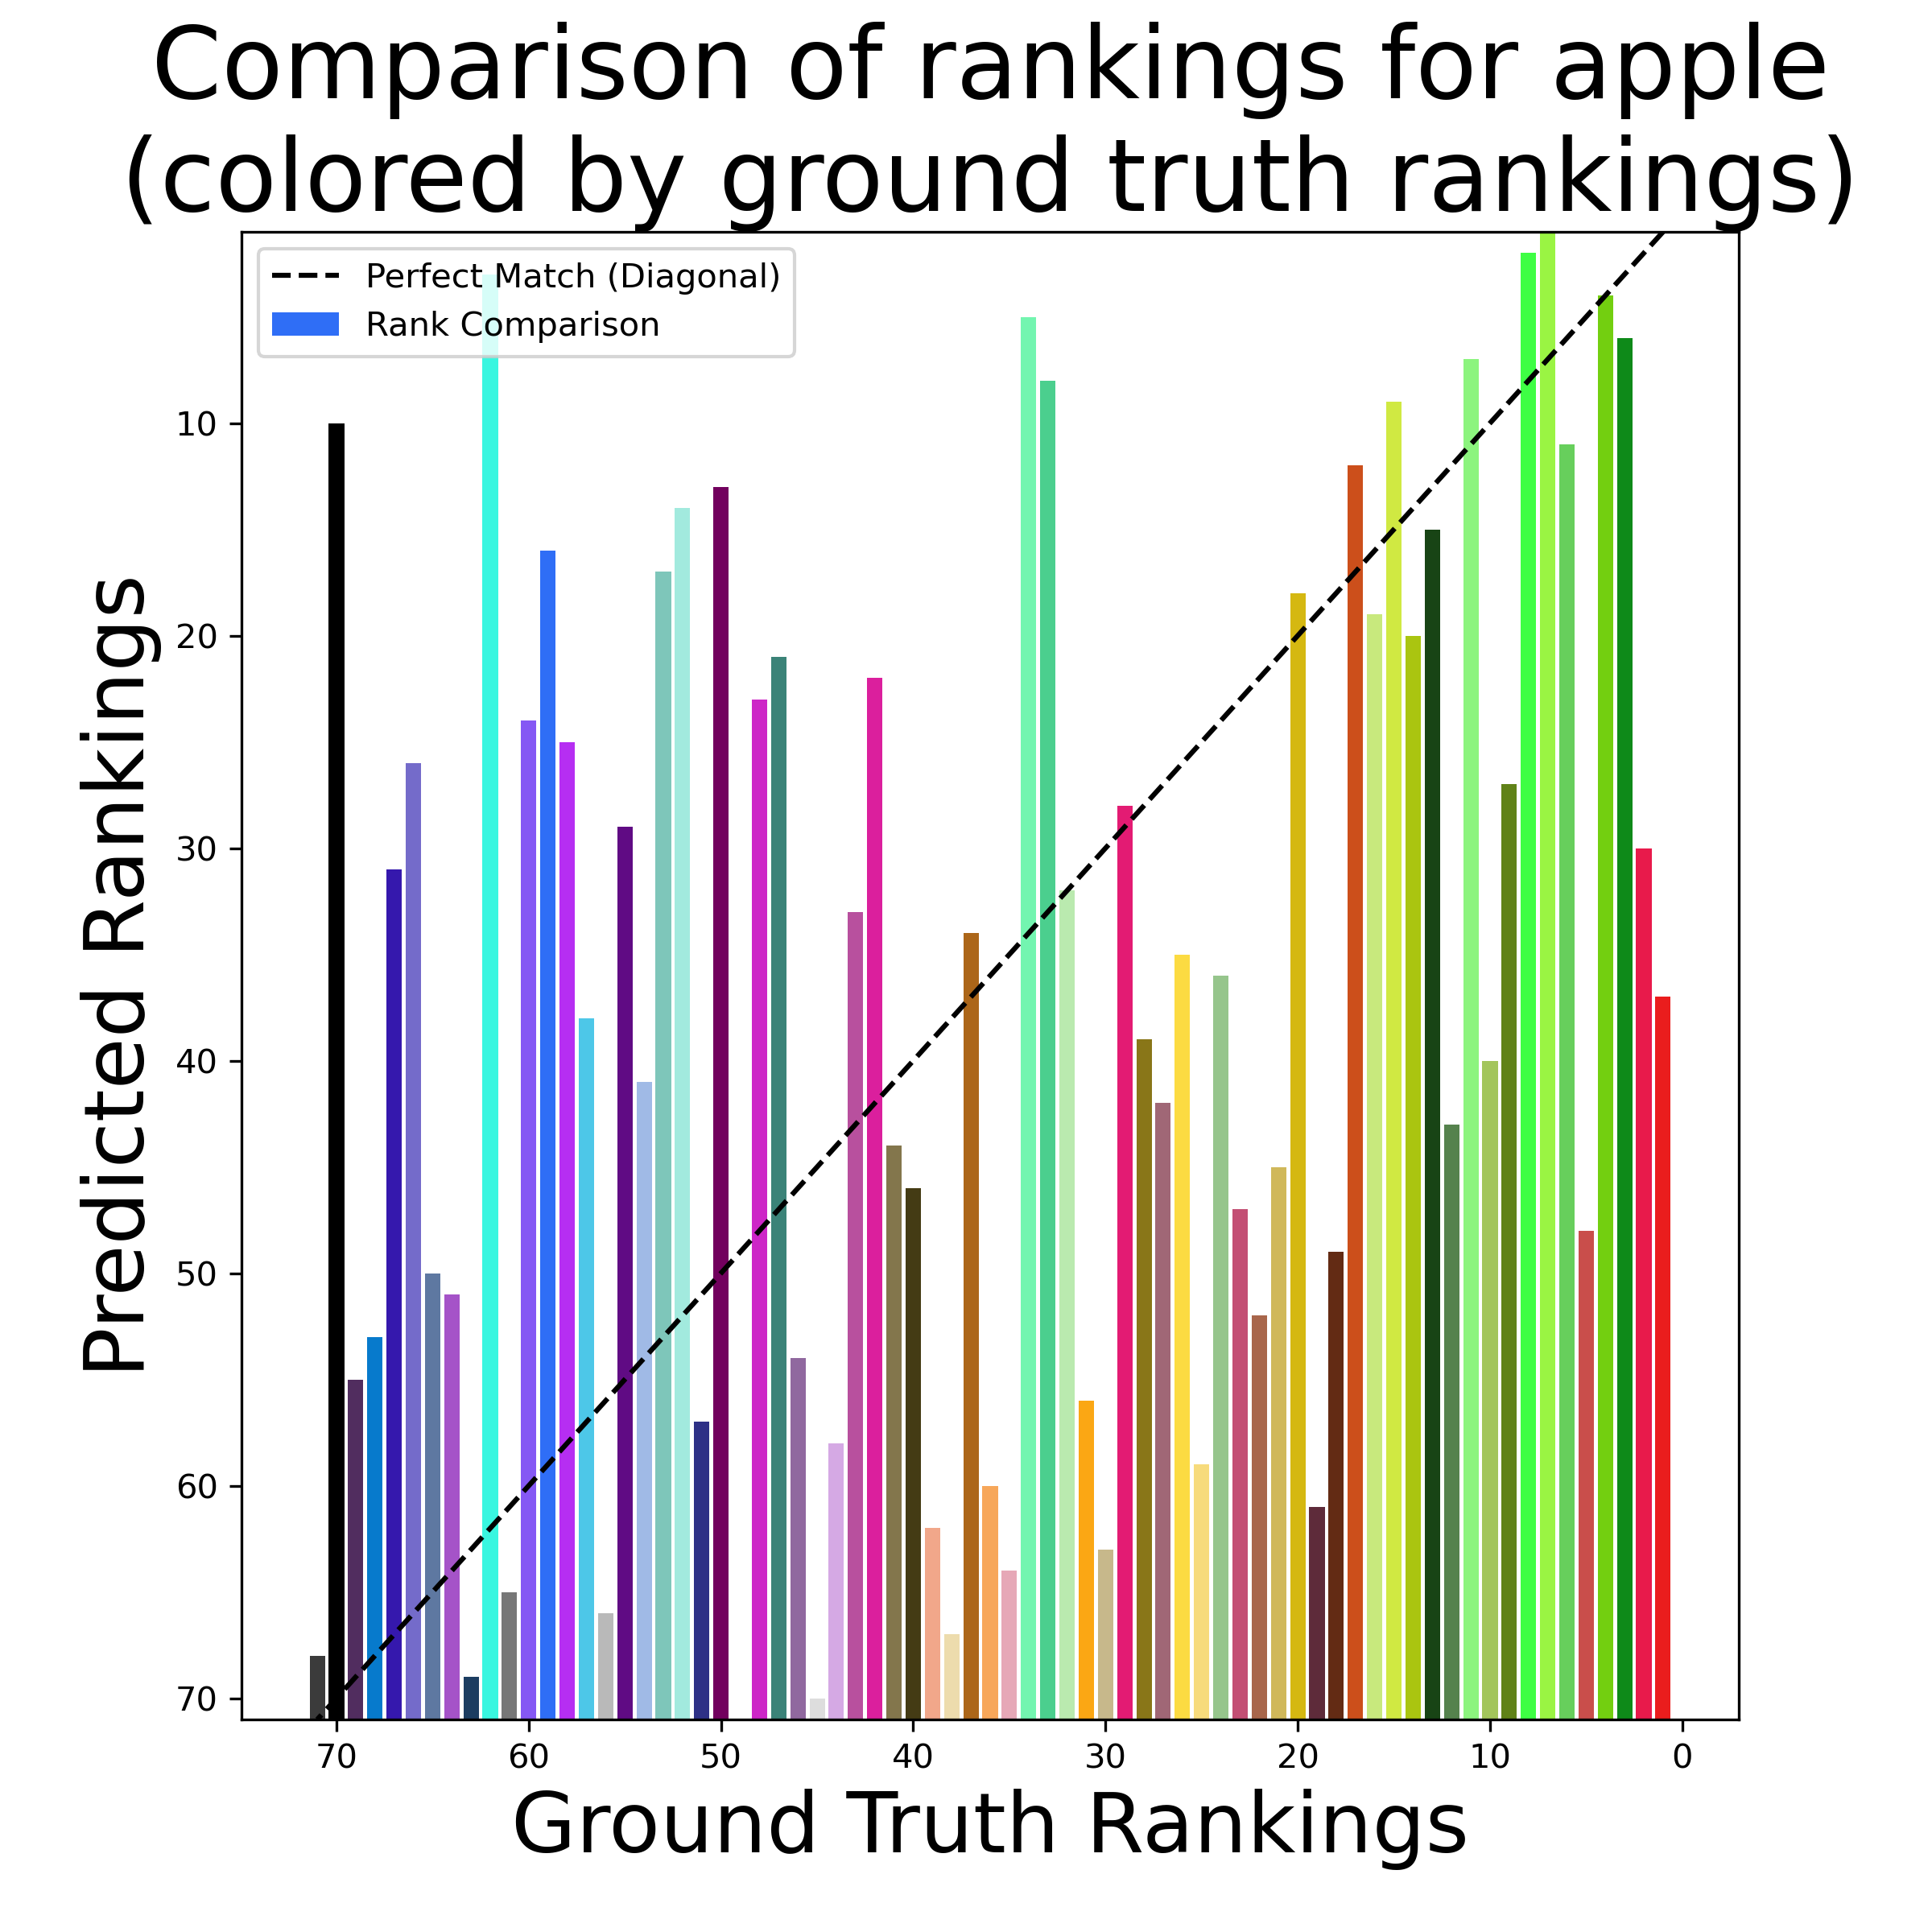
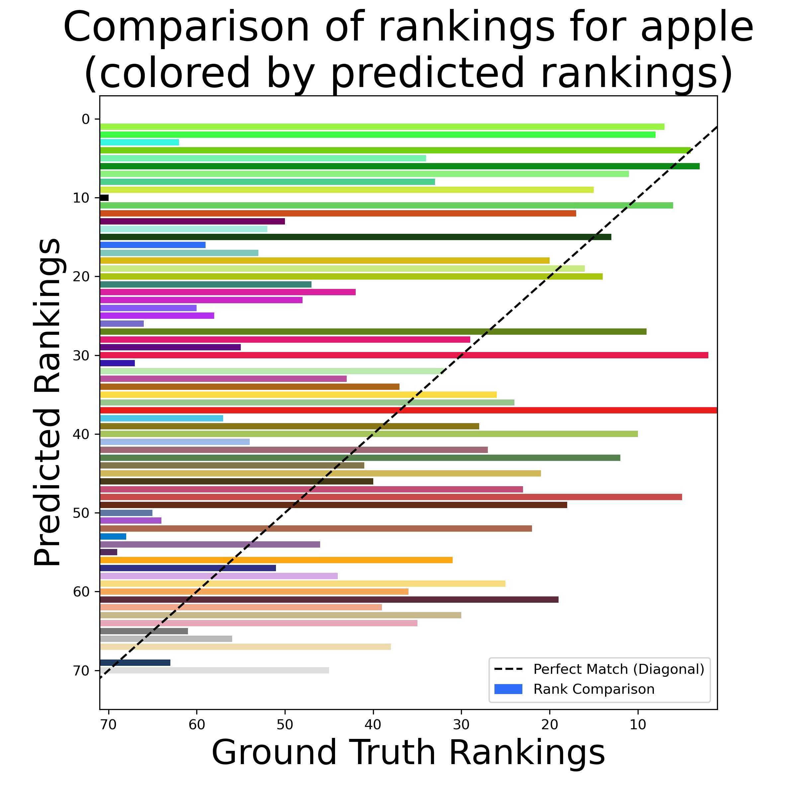
Predicted vs Ground Truth Rankings

Slide 22
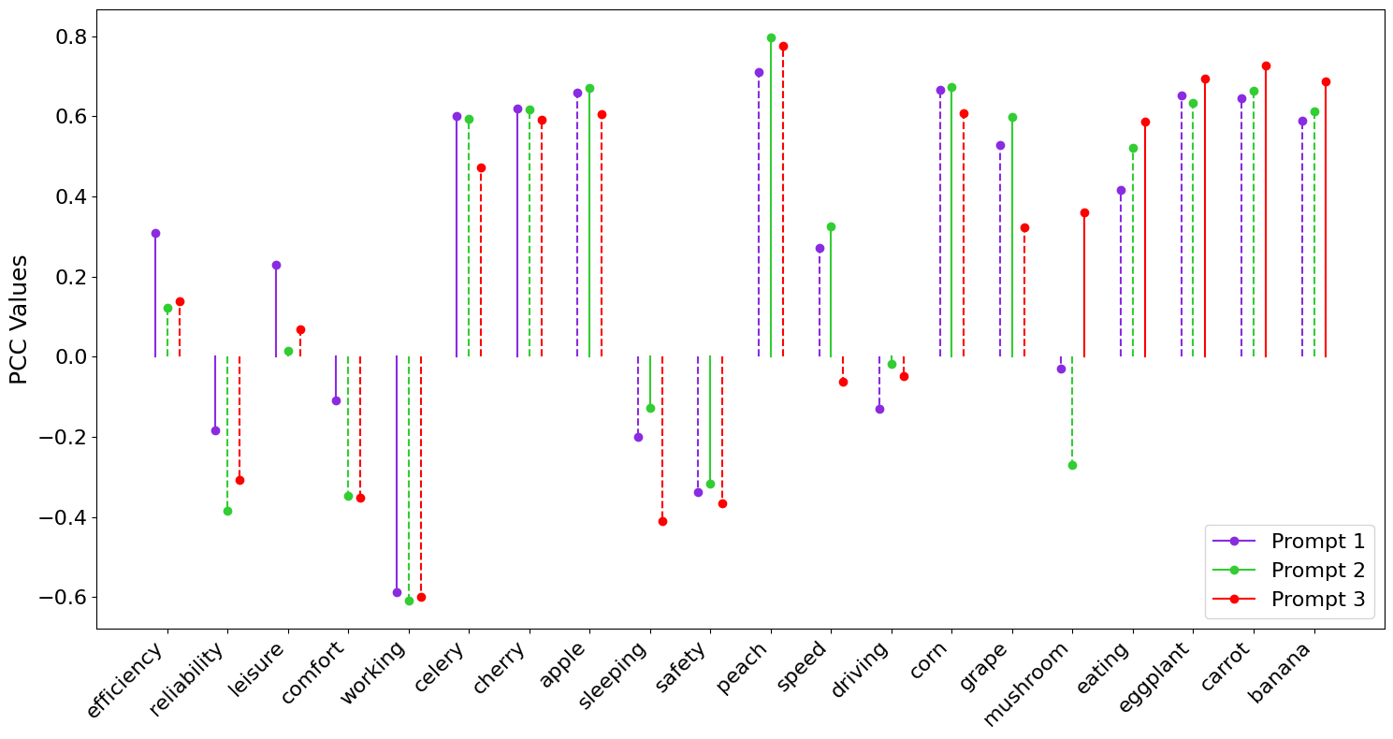
Performance across concepts
CLIP ViT 32
Prompt 1: The color of the image represents the word <concept>
Prompt 2: The concept <concept> is well represented by the color of the image.
Prompt 3: The color of the image is associated with the concept <concept>
Notes:
This plot shows the performance of our model across the 20 concepts we considered. The bars above 0 indicate a concept for which our model’s predicted color distribution positively correlated with the ground truth, while the bars below 0 indicate a concept for which our model’s predicted color distribution negatively correlated with the ground truth. We see a clear distinction in which our plot performs well on traditionally colorable physical objects and poorly on abstract concepts. Interestingly, we see two outliers to this. First, our model performs well on “speed,” which can be explained by the ground truth color distributions, in which “speed” is highly associated with red and green even though it is an abstract concept. Second, our model performs poorly on “mushroom” which may be because our model handles shades of grey poorly.
This plot also shows the performance on three variations of our prompt, each of which use a slightly different sentence structure. Generally, the behavior on these prompts is similar, with no consistent top performer. This plot only shows the ViT 32 model, but we saw similar results with the Microsoft model.

Slide 23
Why else may we be underperforming for concepts like: working, sleeping, mushroom, driving, and comfort
Underperforming for white and greys TODO laura to make visual and show common theme among things we did bad with are related to under-associating greys & white

Slide 24
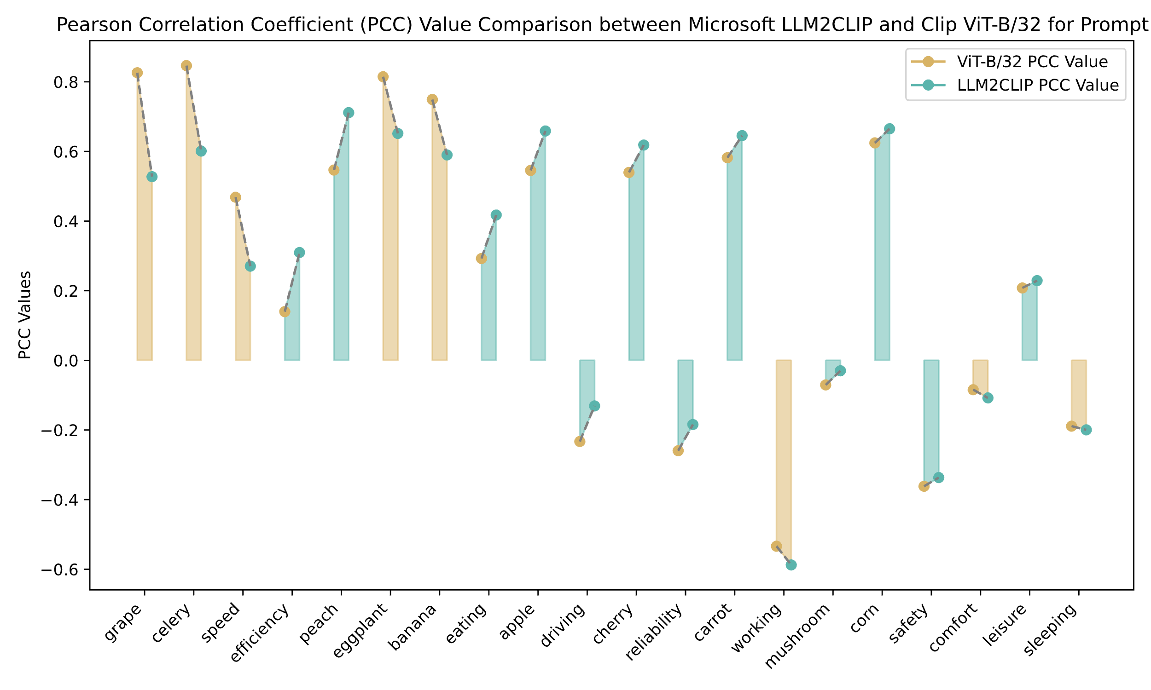

Model Comparison
Prompt 1
Notes:
This plot shows the difference in performance between the ViT B 64 model and Microsoft’s LLM2CLIP model. For each category, the left dot indicates the ViT model performance and the right dot indicates the LLM2CLIP performance. The plot is ordered left to right by gap in model performance and the bars are colored by the better performing model. So we see that the LLM2CLIP model outperformed ViT 64 on slightly more than half of the categories, but there were larger performance gaps for the concepts that ViT 64 model performed better on. Overall, both models performed similarly, and we don’t have evidence to support the use of one over the other.

Slide 25
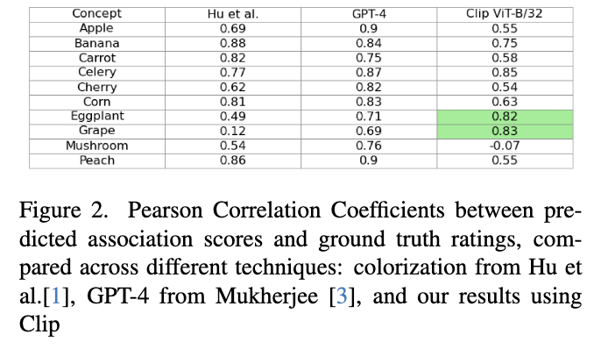
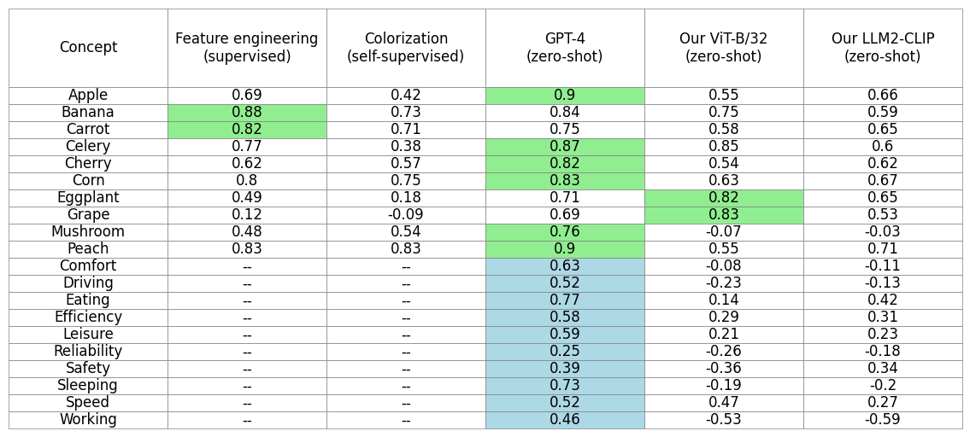
Comparison with previous methods (PCC)
Prompt 1
Notes:
Finally, we compared our models against the previous methods that we discussed earlier. The first column is the feature engineered, fully supervised method which requires human-labelled data to train, making it the most expensive method. The second column is the colorization method that requires only a set of images per concept. The third column is the technique leveraging Chat GPT-4, and the last two columns are our two models. Note that these last 3 techniques require pretrained LLMs but don’t require any task-specific training data. The first two methods only provided data on objects, so we don’t have correlations for the abstract concepts.
As you can see, the GPT-4 approach consistently outperforms the other approaches. Although outperformed by the GPT-4 approach and feature engineering approach, our model performs similarly to the colorization approach, and notably does not require task-specific training data.

Slide 26
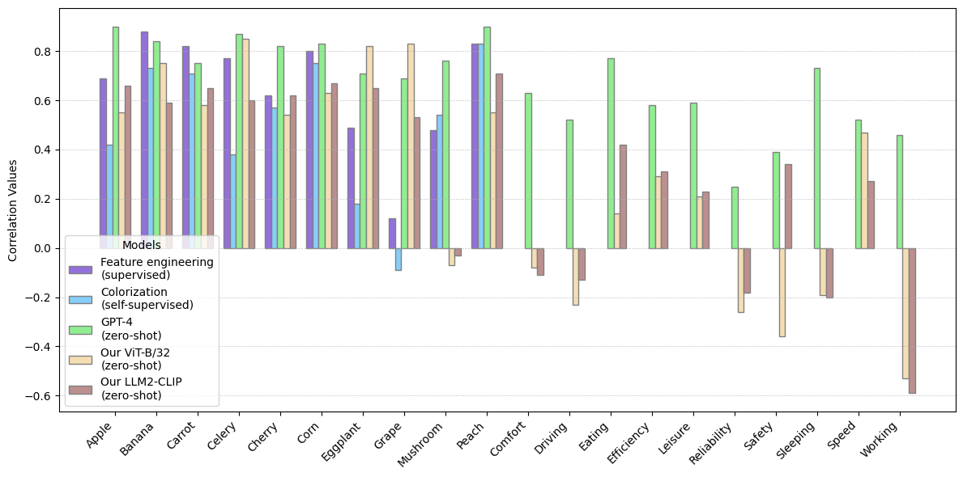
Comparison with previous methods (PCC)
Prompt 1
Notes:
This is the same data shown as a plot. If we look at the right hand side of the plot, we see that the GPT-4 approach vastly outperforms our model when it comes to abstract concepts.

Slide 27
Next steps
Exp 3: Text to image generation
using a weighted scoring system based of distances in CIE Color Lab space to determine if text to image approach could also be feasible
Model evaluation metrics

Slide 28

Questions?

Slide 29
References
To do

